Slide 1
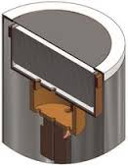
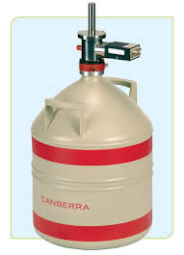
Hyper-Pure Germanium in Planar Configuration
A HP Ge is a cooled solid state detector
HP Ge
LN2 Dewar
Charges Sensing Preamplifier

Slide 2
Hyper-Pure Germanium in Planar Configuration
γ
p+ contact (0.3µm B)
Electrode connected to HV
High Voltage (-)
10mm
Na # 10¹⁰/cm³
Germanium
cooled detector
→ Low reverse current
n+ contact (0.7mm Li))
Electrode
connected
to CSP
(virtual ground)
Rf
Cf
-
Spectroscopy
amplifier
Charge Sensing Preamplifier
+
… explanations later …

Slide 3
Hyper-Pure Germanium in Planar Configuration
Number of charges created by incident particle:
$$N=\frac{hν}{ω}=\frac{122keV}{3eV}=40666 quanta$$
Statistics:
$$σ=\sqrt{F∙N}=\sqrt{0.13∙40666}=73 quanta=220{eV}_{RMS}$$
Where ? Well, in fact everywhere, but locally…

Slide 4
Hyper-Pure Germanium in Planar Configuration
Z
Electric field in the detector :
-HV
Th
$$\vec{E}$$
Na # 10¹⁰/cm³
Solve :
$$\frac{d^{2}V}{dz^{2}}=−\frac{ρ}{ε_{r}∙ε_{0}}=\frac{e∙Na}{ε}$$
0V
z=0
For simplicity, in fact
Meas. Electrode is reduced at
Its minimal size in order to
Reduce detector Cap.
… explanations later …
With boundaries conditions :
$$V\left(z=0\right)=0V$$
$$V\left(z=Th\right)=−HV$$
To obtain :
$$E=\frac{HV}{Th}+\frac{e∙Na}{ε}∙\left(\frac{Th}{2}−z\right)$$

Slide 5
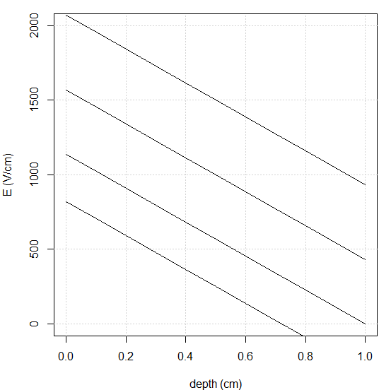
Hyper-Pure Germanium in Planar Configuration
Z
Electric field in the detector :
-HV
$$E=\frac{HV}{Th}+\frac{e∙Na}{ε}∙\left(\frac{Th}{2}−z\right)$$
Th
$$\vec{E}$$
Na # 10¹⁰/cm³
0V
z=0
1500V
HV = 1500V (negative)
Th = 1cm
1000V
In our example
568V
250V

Slide 6
Hyper-Pure Germanium in Planar Configuration
Z
Secondaries transport :
In our example
z=2mm
-HV
Th
N e-/h
$$\vec{E}$$
z
0V
z=0
electrons
holes
Are moving
At velocity
$$v_{e}=μ_{e}∙E$$
$$v_{h}=μ_{h}∙E$$
Mobility (#constant)
$$μ_{e}≈3900{cm}^{2}V^{−1}s^{−1}$$
$$μ_{h}≈1900{cm}^{2}V^{−1}s^{−1}$$

Slide 7
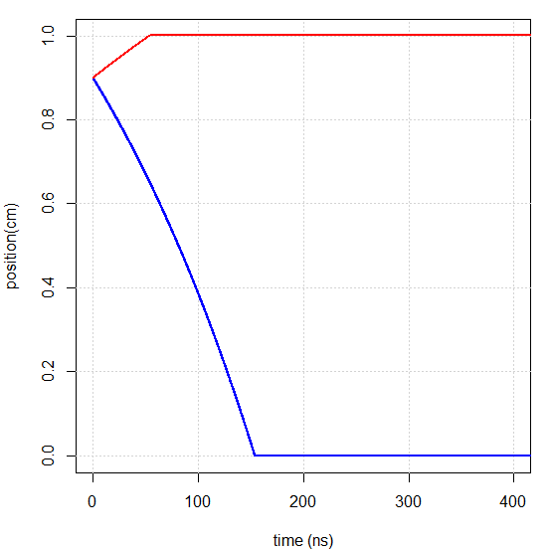
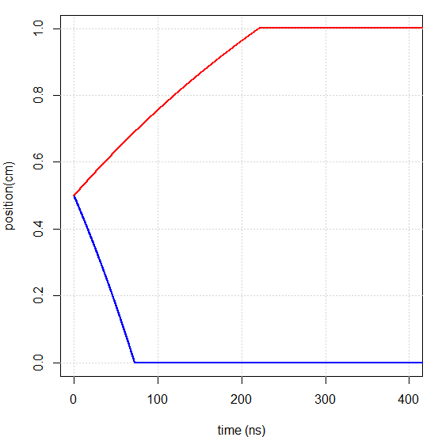
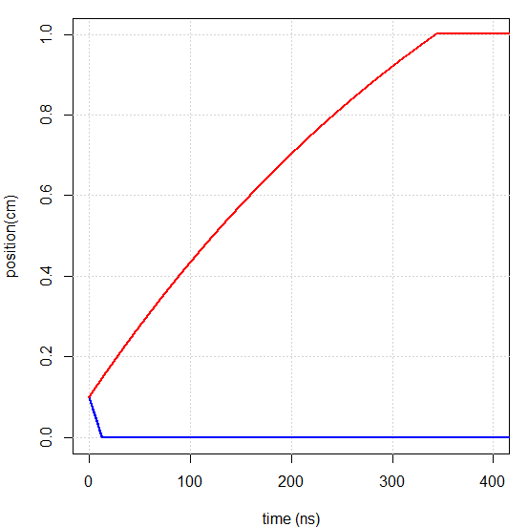
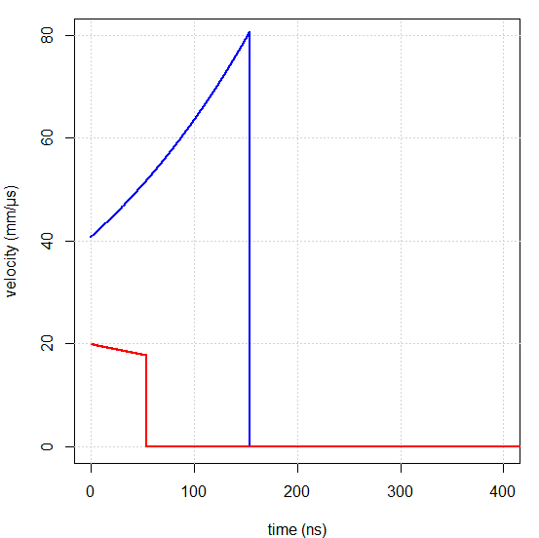
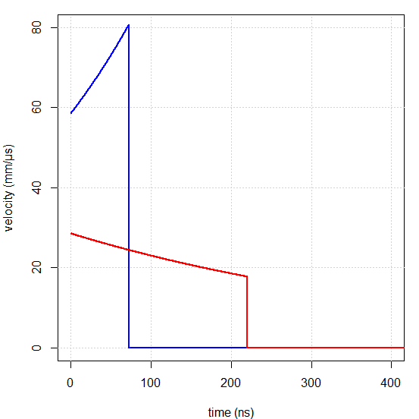
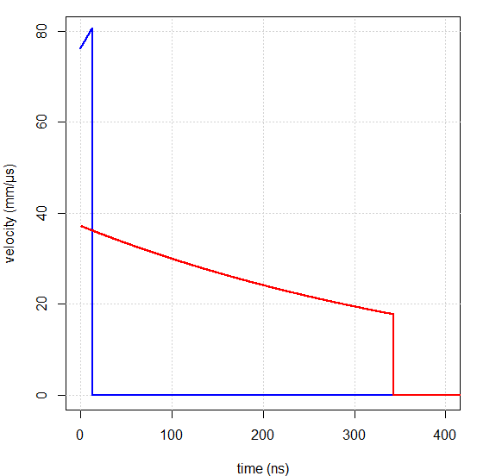
Hyper-Pure Germanium in Planar Configuration
Secondaries transport : a cumbersome problem…
→ Use numerical integration !
$$M\left(t+dt\right)≈M\left(t\right)+v\left(M\left(t\right)\right)∙dt$$
holes
position
electrons
velocity

Slide 8
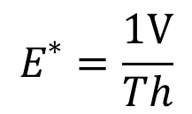
Hyper-Pure Germanium in Planar Configuration
Z
Ramo virtual field :
0V
Th
$$\vec{E^{∗}}$$
Uniform E field
Remove all space charges
Put 1V on measuring electrode
Put 0V on others electrodes
1V
z=0
$$E^{∗}=\frac{1V}{Th}$$
Intensity :

Slide 9
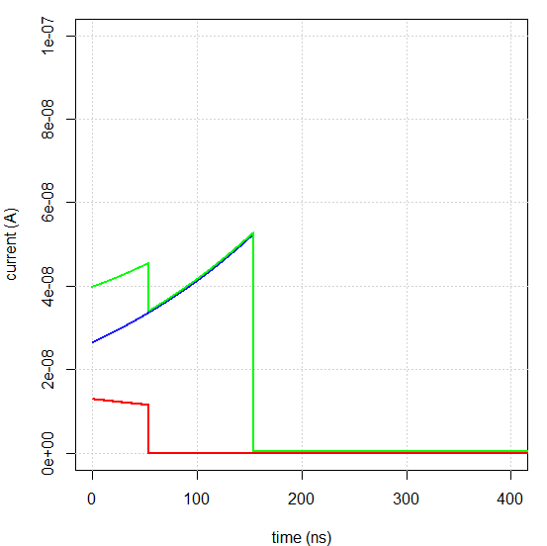
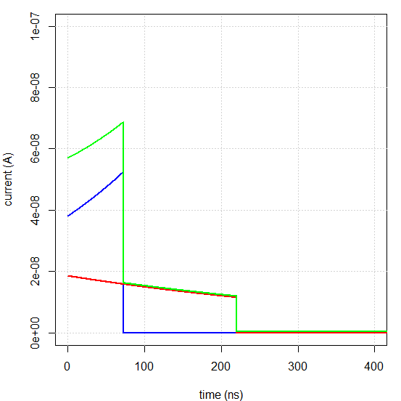
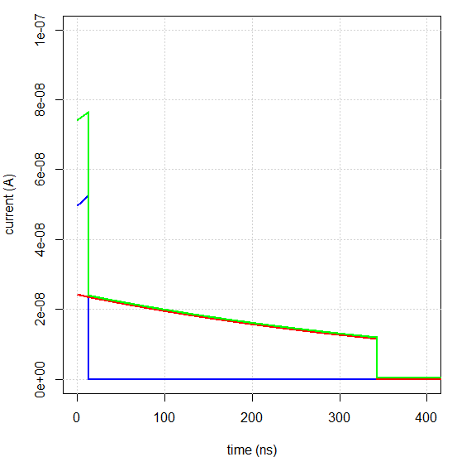
Hyper-Pure Germanium in Planar Configuration
Z
Current generator :
0V
Th
$$i\left(t\right)=−q∙\frac{\vec{v}\left(\vec{M}\left(t\right)\right)∙\vec{E^{∗}}}{1V}$$
1V
z=0
Q=40666 x 1.6e-19 C = 122keVGe
100nA
-i(t)
Total
Electrons
Holes

Slide 10
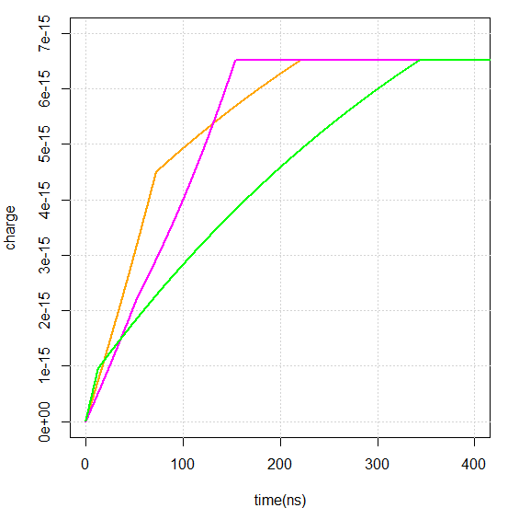
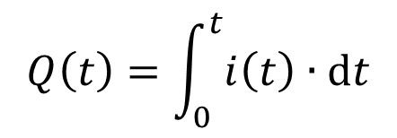
Hyper-Pure Germanium in Planar Configuration
And total charge :
Q=40666 x 1.6e-19 C = 122keVGe
$$Q\left(t\right)=\int_{0}^{t}{i\left(t\right)∙dt}$$
Same total charge
Z
z=0.9
Various rise-times
1fC
z=0.5
z=0.1
z=0

Slide 11
Hyper-Pure Germanium in Planar Configuration
Total charge is independent (in amplitude) of interaction position
Rise-time variability gives rise to ballistic deficit
Current shape depends on interaction position
→ can be used to estimate it…
That’s all folks!

