Slide 1
Electrons capture in the air
The subject:
Medical Ionization Chambers are air filled ICs
In the air, electrons are captured by O2
→ forming O2- (this is just the beginning of the story…)
When increasing dose rate, we increase recombination rate
X₊ + Y₋ → X + Y
Recombination depends on the time ions spend mixing
→it is useful to know how many electrons (fast)
are captured to form O2- (slow).
How to perform this measurement a direct way?

Slide 2
Electrons capture in the air
Before answering, let’s play with Ramo Theorem…
Suppose we do something like that… What would we get?
+HV
5mm
Nitrogen atm. P
Voltage gain = 50
Rg
Rf
-
+
Virtual ground
50Ω
Incident α particle
Simple wide-band line receiver
We will see later

Slide 3
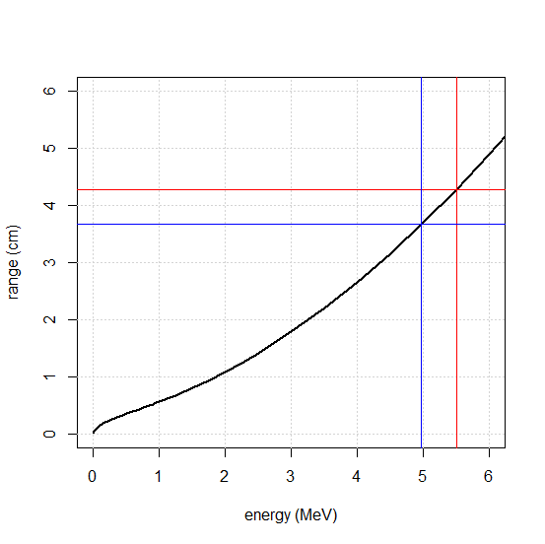
Electrons capture in the air
What : electrons/ions pairs
Number of charges created by incident particle (5.5MeV α)
4.27cm
α in Nitrogen
3.67cm
$$N=\frac{∆E}{ω}≈\frac{0.5MeV}{36eV}=13900$$
Where : uniformly along the trajectory
ΔE= 0.5MeV
out
5.0 MeV
in
5.5 MeV

Slide 4
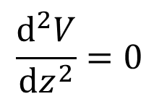
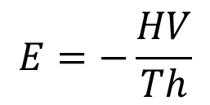
Electrons capture in the air
Z
Electric field in the detector :
+HV
Th
$$\vec{E}$$
Solve :
$$\frac{d^{2}V}{dz^{2}}=0$$
0V
z=0
To obtain :
$$E=−\frac{HV}{Th}$$
This time, that was easy, isnt’it?
Surprises will come later…

Slide 5
Electrons capture in the air
Z
Secondaries transport :
For instance
Th=6mm
HV=1000V
→E=1666V/cm
+HV
Th
$$\vec{E}$$
0V
z=0
electrons
ions
Are moving
At velocity
$$v_{e}=μ_{e}∙E$$
$$v_{h}=μ_{h}∙E$$
Same E → same velocity everywhere
Mobility (#constant)
$$μ_{e}≈1000{cm}^{2}V^{−1}s^{−1}$$
$$μ_{h}≈2{cm}^{2}V^{−1}s^{−1}$$

Slide 6
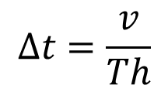
Electrons capture in the air
Secondaries transport : not a cumbersome problem…
→ make it by hand!
For electrons:
$$\vec{v}$$
$$\vec{E}$$
Full collection
time
charges
N
time
$$∆t=\frac{v}{Th}$$
Δt # 360ns

Slide 7
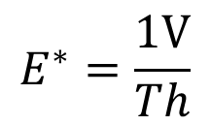
Electrons capture in the air
Z
Ramo virtual field :
0V
Th
$$\vec{E^{∗}}$$
Uniform E field
Remove all space charges
Put 1V on measuring electrode
Put 0V on others electrodes
1V
z=0
$$E^{∗}=\frac{1V}{Th}$$
Intensity :

Slide 8

Electrons capture in the air
Current generator :
0V
Th
$$i\left(t\right)=−q∙\frac{\vec{v}\left(\vec{M}\left(t\right)\right)∙\vec{E^{∗}}}{1V}$$
1V
z=0
For electrons:
$$i_{max}=N∙e∙μ_{e}∙E∙\frac{1}{Th}$$
imax # 6.2 nA
Full collection
time
Current (A)
time
$$∆t=\frac{Th}{v}$$
Δt # 360ns
instrumentation examples
8

Slide 9
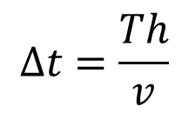
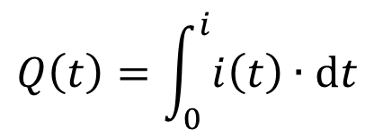
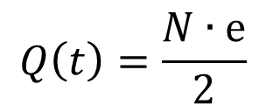
Electrons capture in the air
And total charge :
Funny, isn’t it?
$$Q\left(t\right)=\int_{0}^{i}{i\left(t\right)∙dt}$$
$$Q\left(t\right)=\frac{N∙e}{2}$$
For electrons:
$$i_{max}=N∙e∙μ_{e}∙E∙\frac{1}{Th}$$
Full collection
time
Current (A)
time
$$∆t=\frac{Th}{v}$$

Slide 10
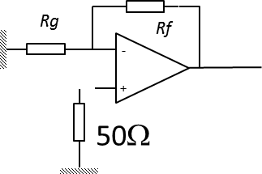
Electrons capture in the air
And now, show time!
FASTER D.A&P.S.
PM tube
start
Plastic scintillator
+HV
Signal
0V
5.5 MeV α source
We don’t want to distort signals… which are very very small!
It’s Ad time: you need a numerical state of the art, general purpose
Digital Acquisition System? Have a look @ faster.in2p3.fr

Slide 11
Electrons capture in the air
And now, show time!
We want to measure 50x50x6.2nA # 15 µV
Noise # 600µV_{RMS}
Acquire each signal triggered by PM & average them
With 1Mhits :
Signal is always 15 µV
Noise # 600µV_{RMS} / 1M^{½} = 0.6µV_{RMS}

Slide 12
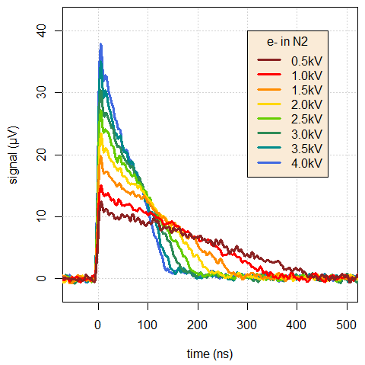
Electrons capture in the air
And now, show time!
Energy loss =13900 charges
Detector HV = 1kV
imax # 6.2 nA
Δt # 360ns
Line receiver preamp.
Rl = 50Ω
Voltage gain = 50
Vmax # 15 µV

Slide 13
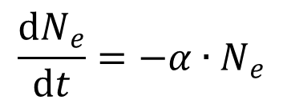
Electrons capture in the air
What happens in the air?
For a given HV :
$$\frac{dN_{e}}{dt}=−α∙N_{e}$$
Free electrons are captured at constant rate :
The shape of current becomes :
$$triangle\left(t\right)∙\exp\left(−α∙t\right)$$

Slide 14
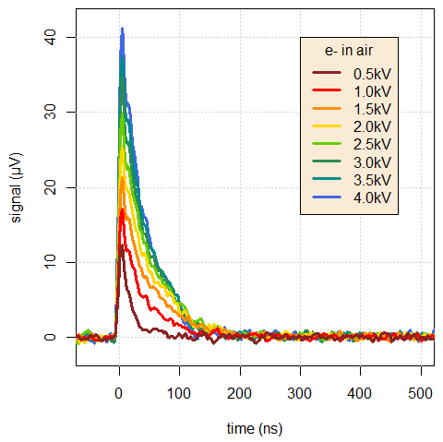
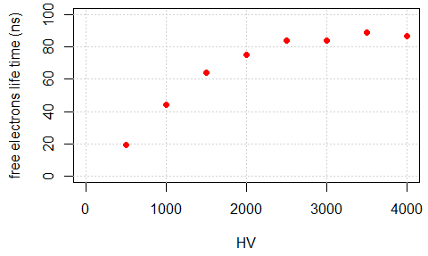
Electrons capture in the air
The show goes on :

Slide 15
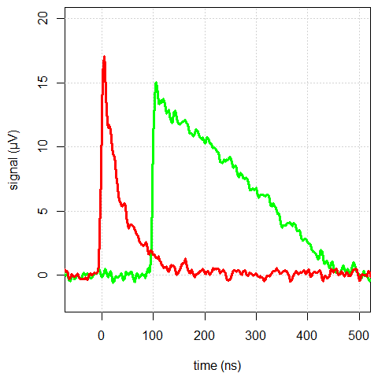
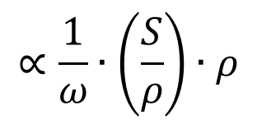
Electrons capture in the air
Ramo, it works!
air
Look at the beginning :
nitrogen
$$∝\frac{1}{ω}∙\left(\frac{S}{ρ}\right)∙ρ$$
Currently admitted values
 | air | nitrogen
ω (eV) | 35.1 | 36.4
S/ρ (MeV.cm²/g) | 7.12 10² | 7.21 10²
ρ (g/cm³) | 1.205 10⁻³ | 1.165 10⁻³
I prop to | 2.44 | 2.31
Ratio → 1.06

Slide 16
Electrons capture in the air
This work was performed by Guillaume Boissonnat (Thx G. !)
Ramo-Shockley theorem is a wonderful tool for
signal prediction
It describes exactly what happens in your detector
If you don’t observe what you predicted
→ your model (detector, physics) is false
→ your detector doesn’t work properly
That’s all folks!

