Slide 1
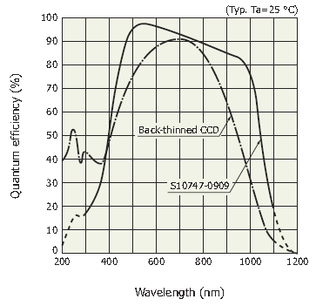
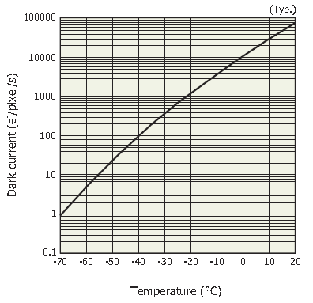
Uncertainty in light measurement
For light sensors, uncertainty is closely related to light intensity
… but not only…
Let’s have a look at an exceptional sensor, the CCD
Readout noise
Typ. 30 e-_{RMS}
Down to a few
e-_{RMS}

Slide 2
Uncertainty in light measurement
In the charges domain:
accumulation phase ΔT
photons
$$PE=Qeff∙\overline{\frac{dN_{hν}}{dt}}∙∆T$$
1 pixel
$$ThE=i_{dark}∙∆T$$
Dark current
Readout phase:
$$PE+ThE±readout noise$$

Slide 3
Uncertainty in light measurement
In the charges domain:
$${σ_{meas}}^{2}={σ_{PE}}^{2}+{σ_{ThE}}^{2}+{σ_{RO}}^{2}$$
Follow a Poisson law
Given by the constructor
$${σ_{Poisson\left(N\right)}}^{2}=N$$
$σ_{RO}$=30
$$σ_{meas}=\sqrt{PE+ThE+900}$$
So, we need more than 900 PE to overcome electronics noise

Slide 4
Uncertainty in light measurement
$$σ_{meas}=\sqrt{PE+ThE+900}$$
So, we need more than 900 PE to overcome electronics noise
By increasing exposure time, we get :
$$σ_{meas}=\sqrt{Qeff∙\overline{\frac{dN_{hν}}{dt}}∙∆T+i_{dark}∙∆T+900}$$

Slide 5
Uncertainty in light measurement
And SNR becomes :
Increases as
$$\sqrt{∆T}$$
$$\frac{PE}{σ_{meas}}=\frac{\sqrt{Qeff∙\overline{\frac{dN_{hν}}{dt}}∙∆T}}{\sqrt{1+\frac{i_{dark}}{Qeff∙\overline{\frac{dN_{hν}}{dt}}}+\frac{900}{Qeff∙\overline{\frac{dN_{hν}}{dt}}∙∆T}}}$$
Does not change
decreases
That’s why astro-photographers use cooled sensors (to reduce i)
and long exposures (to limit Readout noise incidence)

Slide 6
Uncertainty in light measurement
But, there are other kinds of photodetectors, why not use them?
SiPM (=MPPC), emCCD (electron multiplying CCD), PM tube, …
All these devices provide internal gain that should help…
For real, do you believe it???
Let’s have a look at the amplification & other processes…

Slide 7
Uncertainty in light measurement
PM tubes: Beware: it is PM specific…
Quantum efficiency # 30%
Dark counts # 1000 c/s
Amplification process :
PE are accelerated and when they hit the first dynode
each produces #4 secondary electrons, etc…
At the end of the process (10 dynodes for inst.)
we get #4¹⁰ electrons # 1M for a single PE
Single PE spectrum is mainly governed by first dynode statistics
it is about a Poisson process of mean =4

Slide 8
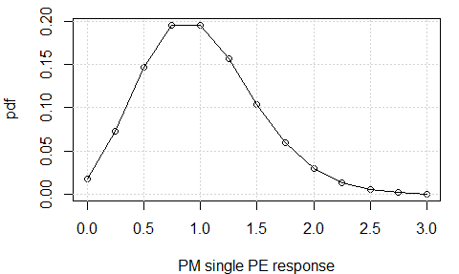
Uncertainty in light measurement
PM tubes: Beware: it is PM specific…
Quantum efficiency # 30%
Dark noise # 1000 c/s
mean = 1
Std. Dev # 1/2
Pulses time interval in counting mode >> 10ns

Slide 9
Uncertainty in light measurement
MPPC: Beware: it is MPPC specific…
Quantum efficiency # 40%
Dark counts # 600 k c/s
Amplification process :
Single pixel avalanche: very very clean!!!
Gain # 2.10⁶

Slide 10
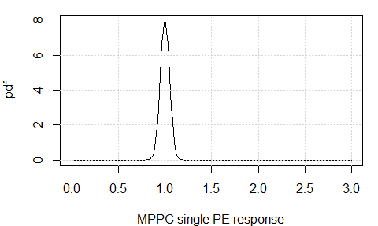
Uncertainty in light measurement
MPPC: Beware: it is MPPC specific…
Quantum efficiency # 40%
Dark counts # 600 k c/s
mean = 1
Std. Dev # 0.05
Pulses time interval in counting mode >> 100ns

Slide 11
Uncertainty in light measurement
emCCD: Beware: it is emCCD specific…
Quantum efficiency # 90%
Dark counts < 0.01 c/s
Amplification process :
Avalanche register. Hundreds of pixels, each with average
amplification probability of about 2%
Gain a few 10³
Single PE spectrum is about an exponential process of mean =1

Slide 12
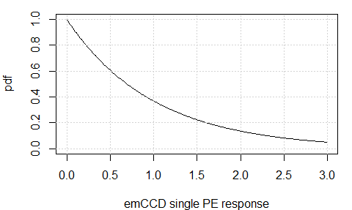
Uncertainty in light measurement
emCCD: Beware: it is emCCD specific…
Quantum efficiency # 90%
Dark counts < 0.01 c/s
mean = 1
Std. Dev # 1
Pulse time interval in counting mode >> a few ms
depending on integration time

Slide 13
Uncertainty in light measurement
There are two ways to use a photodetector
Counting mode
Integration mode
threshold
+1
+1
+1
+1
=4
Int. gate
=6.37
Not CCD!
All detectors

Slide 14
Uncertainty in light measurement
Counting mode
$$m=Qeff∙\overline{\frac{dN_{hν}}{dt}}∙∆T+i_{dark}∙∆T−\overline{i_{dark}}∙∆T$$
We need to « zero » our measurement
Zeroing is often a difficult task:
it shall be done for a duration longer than experiment
in order its uncertainty stay lower than experiment’s one
You must check its stationarity (i.e. it doesn’t vary, or if it does,
at what speed)
Counting mode is “not” affected by gain variations.

Slide 15

Uncertainty in light measurement
Charge integration mode
Same requirements for signal as in counting mode except:
You must check the gain of the system
Statistics plays us some funny tricks
We do not measure with fluctuations on N
$$m=Gain∙N$$
$$m=\sum_{N}{g_{i}}$$
But, in fact with both fluctuations on
the number of PEs and individual gain for each PE

Slide 16
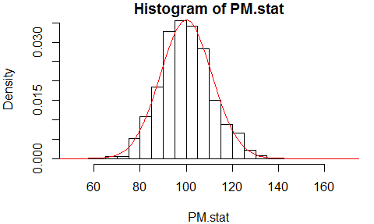
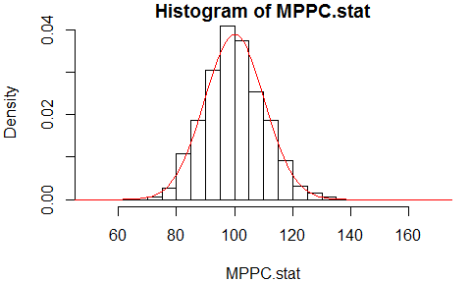
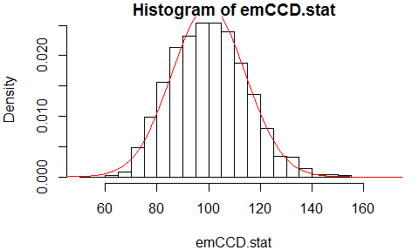
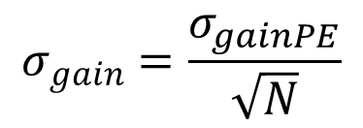
Uncertainty in light measurement
Charge integration mode
In fact, our measurement can be seen as an
Experiment on both number of Pes and gain.
This way :
0.5
1.25
$$m=Gain∙N$$
Gives rise to the combined uncertainty :
0.05
1.00
$${σ_{m}}^{2}={gain}^{2}∙{σ_{N}}^{2}+N^{2}∙{σ_{gain}}^{2}$$
With :
$$σ_{gain}=\frac{σ_{gainPE}}{\sqrt{N}}$$
$$σ_{N}=\sqrt{N}$$
and,
1
2.00
$$σ_{m}≈gain∙\sqrt{N∙\left(1+{\left(\frac{σ_{gainPE}}{gain}\right)}^{2}\right)}$$
For 100 PE

Slide 17
Uncertainty in light measurement
For a specific application,
you shall check every aspect of your detector
Qeff
Dark counts
Unique PE spectrum
…
And see if another one couldn’t
give better results…
This was the trick of the light*:
gain is not necessary your best friend…
* Thx, Mike!
That’s all folks!

