Slide 1
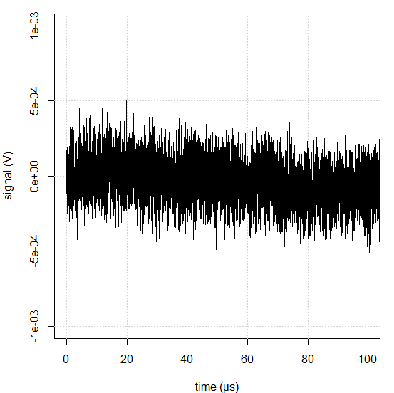
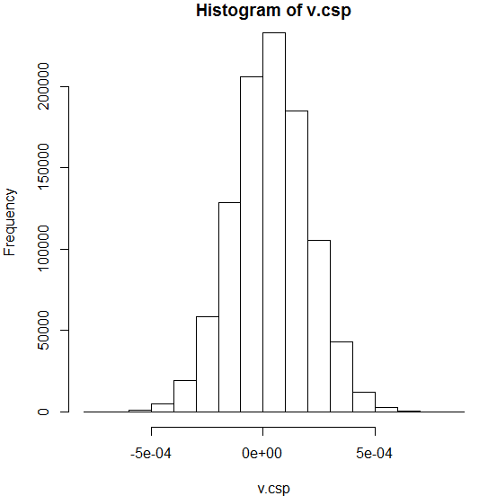
Charges Sensing Preamplifier & noise
A little example of noise measurement
in time domain and frequency domain
I acquired noise after a CSP (sampling 10ns) :
σ = 0.170mV_{RMS}

Slide 2
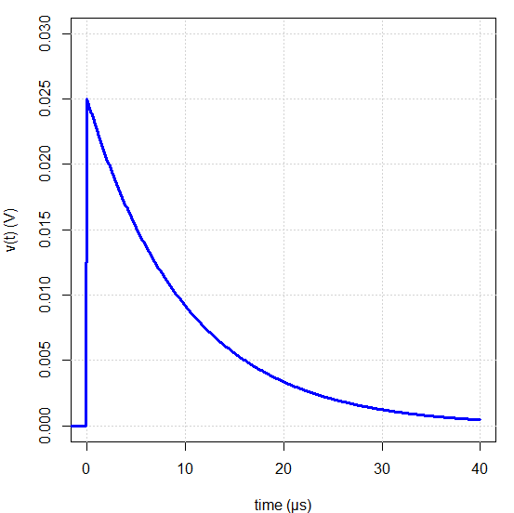
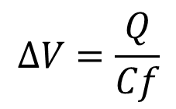
Charges Sensing Preamplifier & noise
We know that Cf=2pF (It’s written on the preamp!)
We know a charge pulse gives a “step” response whose amplitude is
$$∆V=\frac{Q}{Cf}$$
We measured Vrms = 0.160mV
→ the Equivalent Noise Charge (ENC) is
0.34fC = 2100 charges = 7.6keV in Silicon detectors
We will do far better later…

Slide 3
Charges Sensing Preamplifier & noise
For the moment let’s look at the specifications of our system:
Detector :
$$Cd=10pF$$
$$Irev=1nA$$
$$\sqrt{SiIrev}=18fA.{Hz}^{−1/2}$$
CSP :
$$\sqrt{Sioa}=1fA.{Hz}^{−1/2}$$
$$\sqrt{Sitot}=24fA.{Hz}^{−1/2}$$
$$\sqrt{Seoa}=5nV.{Hz}^{−1/2}$$
$$\sqrt{Setot}=5nV.{Hz}^{−1/2}$$
Polarization :
$$Rp=100MΩ$$
$$\sqrt{SiRp}=13fA.{Hz}^{−1/2}$$
Feedback :
$$Rf=100MΩ$$
$$\sqrt{SiRf}=13fA.{Hz}^{−1/2}$$
C$f=2pF$

Slide 4
Charges Sensing Preamplifier & noise
The noise spectral density is :
v.noise <- ts(v.csp, start=0, frequency=1/(0.01e-6))
S <- spectrum(v.noise, spans=c(5,5))
plot (c(100,1e8), c(1e-9,1e-5), type="n", log="xy",
xlab="frequency (Hz)", ylab="spectral density (V/Hz^1/2)")
grid()
lines(S$freq, sqrt(2*S$spec))

Slide 5
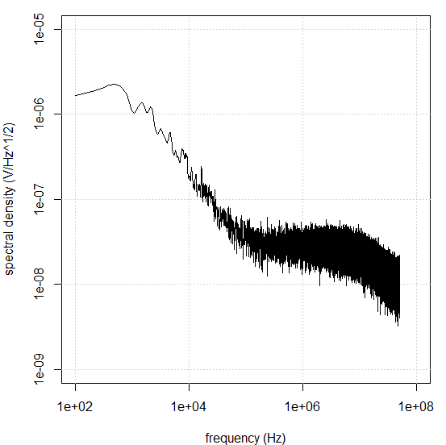
Charges Sensing Preamplifier & noise
The noise spectral density is :

Slide 6
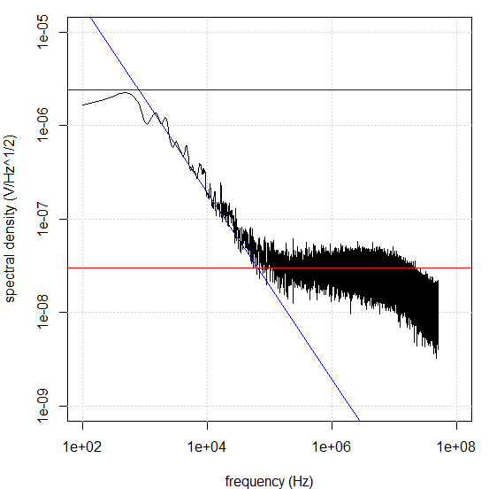
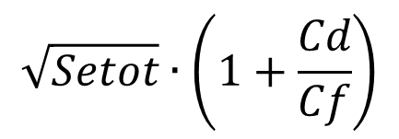
Charges Sensing Preamplifier & noise
Let’s compare it to CSP theory :
$$\sqrt{Sitot}∙Rf$$
$$\sqrt{Setot}∙\left(1+\frac{Cd}{Cf}\right)$$
$$\sqrt{Sitot}∙\frac{1}{2π∙f∙Cf}$$

Slide 7
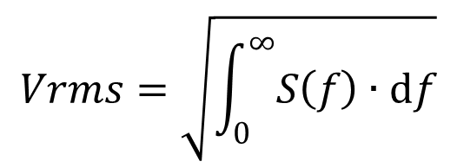
Charges Sensing Preamplifier & noise
$$Vrms=\sqrt{\int_{0}^{∞}{S\left(f\right)∙df}}$$
And, obviously :
Noise can be measured in time domain
But the full description is easier in frequency domain
We are able to select components in order to make less
Noise than the detector itself.
(except the noise voltage of the preamp.)
That’s all folks!

