Slide 1
A complete DIY numerical shaper…
… from scratch!
What do we need?
The signal digitized at the output of a Charge Sensing Preamp.
→ I did it for you.
Numerical filters.
→You will do it !!!
A digital oscilloscope.
→I did it for you.
A digital data acquisition system.
→I did it for you.

Slide 2
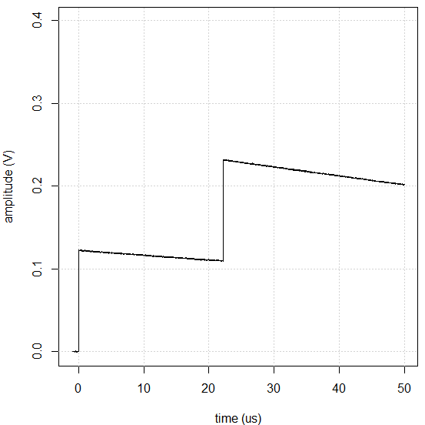
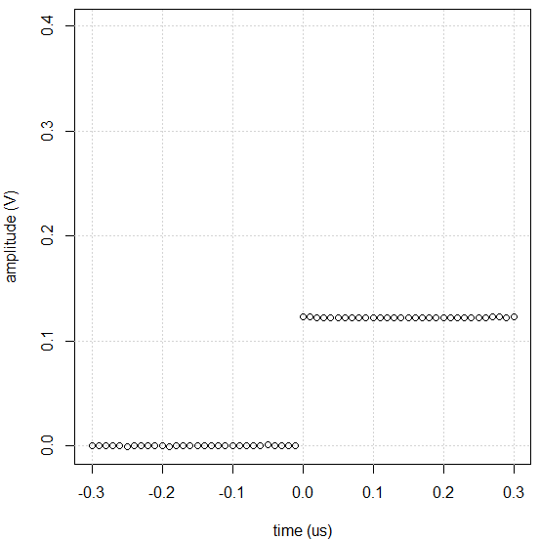
A complete DIY numerical shaper…
… from scratch!
The signal we have to process :
We get consecutive samples
Ts=10ns
$$v_{in}\left[i\right]$$
[…, 0, 0, 0, 0.12, 0.12, 0.12, …]
+ noise !

Slide 3
A complete DIY numerical shaper…
… from scratch!
Let’s build a digital filter :
$$v_{out}\left[n\right]=\sum_{i=0..N−1}{b_{i}}∙v_{in}\left[n−i\right]$$
Output at time n
Is a linear combination of input at times n-i
Filter coefficients
This is a Finite Impulse Response (FIR) filter

Slide 4
A complete DIY numerical shaper…
… from scratch!
You already KNOW some FIRs :
$$v_{out}\left[n\right]=\frac{1}{N}∙\sum_{i=0..N−1}{1∙}v_{in}\left[n−i\right]$$
This one is averaging input signal over N samples
$$v_{out}\left[n\right]=\frac{v_{in}\left[n\right]−v_{in}\left[n−1\right]}{Ts}$$
And this one takes the derivative of the input signal

Slide 5
A complete DIY numerical shaper…
… from scratch!
Let’s build another kind of digital filter :
$$v_{out}\left[n\right]=\sum_{i=0..N−1}{b_{i}}∙v_{in}\left[n−i\right]+\sum_{i=1..N−1}{a_{i}}∙v_{out}\left[n−i\right]$$
Output at time n
Is a combination of input at times n-i
+ output at times n-i
This is an Infinite Impulse Response (IIR) filter
…also known as Recursive Filter
When rounding numbers, IIR are sometimes less stable than FIR,
but if carefully designed, it’s not a problem!

Slide 6
A complete DIY numerical shaper…
… from scratch!
And you already KNOW, at least, one IIR :
$$v_{out}\left[n\right]=Ts∙v_{in}\left[n\right]+v_{out}\left[n−1\right]$$
This filter compute the integral of the input signal

Slide 7
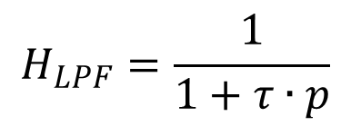
A complete DIY numerical shaper…
… from scratch!
In nuclear instrumentation system design, we usually know :
The input in the time domain → Cf Ramo & Co
$$i_{0}\left(t\right)$$
$$I\left(p\right)=ℒ\left(i_{0}\left(t\right)\right)$$
The transfer function of the system
$$H\left(p\right)=\frac{num}{den}$$
In order to compute the output
$$v\left(t\right)=ℒ^{−1}\left(S\left(p\right)\right)$$
$$S\left(p\right)=H\left(p\right)∙I\left(p\right)$$
For instance :
$$H_{LPF}=\frac{1}{1+τ∙p}$$
$$H_{HPF}=\frac{τ∙p}{1+τ∙p}$$

Slide 8
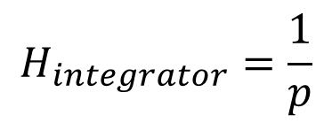
A complete DIY numerical shaper…
… from scratch!
And now, the magic:
$$H_{integrator}=\frac{1}{p}$$
Let’s take a filter, an easy one:
$$p→\frac{1}{Ts}∙\left(1−z^{−1}\right)$$
$$H_{integrator}=\frac{Ts}{1−z^{−1}}$$
Make the substitution :
We got what we call an Auto-Regressive Moving Average
(ARMA) model. That’s all we need to do!!!
R will do the rest for us… in fact, it’s not difficult, but it’s easier & faster to use R

Slide 9
A complete DIY numerical shaper…
… from scratch!
the trick explained:
We just have to write :
$$H_{integrator}=\frac{Ts}{1−z^{−1}}=\frac{v_{out}}{v_{in}}$$
…to get :
$$v_{out}∙\left(1−z^{−1}\right)=v_{in}∙Ts$$
…and, every time we see :
$$v_{in or out}∙z^{−i}$$
we replace by :
$$v_{in ou out}\left[n−i\right]$$
…thus:
$$v_{out}\left[n\right]−v_{out}\left[n−1\right]=Ts∙v_{in}\left[n\right]$$
…then rearrange:
$$v_{out}\left[n\right]=Ts∙v_{in}\left[n\right]+v_{out}\left[n−1\right]$$
It’s crazy, right?

Slide 10
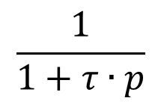
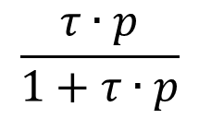
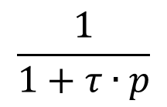
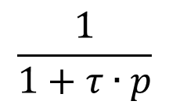
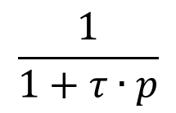
A complete DIY numerical shaper…
… from scratch!
And now, it’s up to YOU…
→You will make a numerical CR-RC4 shaper:
Adjustable Shaping Time
In its simpler version, it is something like that:
$$τ=R∙C$$
Input
(preamp)
output
One HP filter…
…followed by 4 LP filters
$$\frac{τ∙p}{1+τ∙p}$$
$$\frac{1}{1+τ∙p}$$
$$\frac{1}{1+τ∙p}$$
$$\frac{1}{1+τ∙p}$$
$$\frac{1}{1+τ∙p}$$

Slide 11
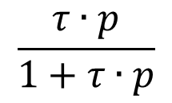
A complete DIY numerical shaper…
… from scratch!
Please, write the ARMA model of the HPF
$$\frac{τ∙p}{1+τ∙p}$$
$$\frac{b_{0}+b_{1}∙z^{−1}+…+b_{n}∙z^{−n}}{a_{0}+a_{1}∙z^{−1}+…+a∙z^{−n}}$$
$$p→\frac{1}{Ts}∙\left(1−z^{−1}\right)$$
$$\left[b_{0},b_{1},…,b_{n}\right]=???$$
$$\left[a_{0},a_{1},…,a_{n}\right]=???$$

Slide 12
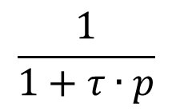
A complete DIY numerical shaper…
… from scratch!
Please, write the ARMA model of the LPF
$$\frac{1}{1+τ∙p}$$
$$\frac{b_{0}+b_{1}∙z^{−1}+…+b_{n}∙z^{−n}}{a_{0}+a_{1}∙z^{−1}+…+a∙z^{−n}}$$
$$p→\frac{1}{Ts}∙\left(1−z^{−1}\right)$$
$$\left[b_{0},b_{1},…,b_{n}\right]=???$$
$$\left[a_{0},a_{1},…,a_{n}\right]=???$$

Slide 13
A complete DIY numerical shaper…
… from scratch!
The R code :
CR.RC4 <- function (s, tau) {
my.HP <- Arma (b = c(tau / dt, -tau / dt),
a = c(1+tau/dt, -tau/dt))
dummy <- filter (my.HP, s)
my.LP <- Arma (b = 1,
a = c(1+tau/dt, -tau/dt))
dummy <- filter (my.LP, dummy)
dummy <- filter (my.LP, dummy)
dummy <- filter (my.LP, dummy)
filter (my.LP, dummy)
}

Slide 14
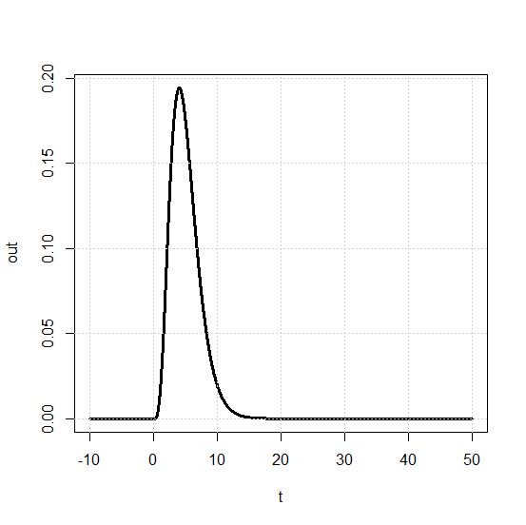
A complete DIY numerical shaper…
… from scratch!
Let’s try it… we will compute its step response :
require (signal)
dt <- 0.01
t <- seq (-10, 50, by=dt)
s <- ifelse (t>=0, 1, 0)
CR.RC4 <- function (s, tau) {
Bla bla bla...
}
out <- CR.RC4(s, 1)
plot (t, out)
shaping time τ=1

Slide 15
A complete DIY numerical shaper…
… from scratch!
Let’s try it…
→ We know the true response (just look at Laplace tables)
Step→
$$\frac{1}{p}∙\frac{τ∙p}{{\left(1+τ∙p\right)}^{5}}=\frac{τ}{{\left(1+τ∙p\right)}^{5}}$$
output→
$$\frac{1}{4!}∙{\left(\frac{t}{τ}\right)}^{4}∙\exp\left(−\frac{t}{τ}\right)$$

Slide 16
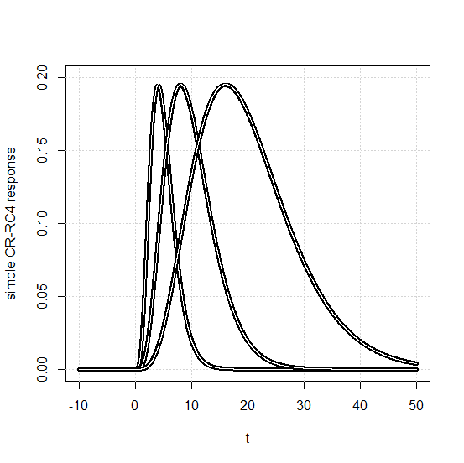
A complete DIY numerical shaper…
… from scratch!
Various shaping time τ=1, 2 and 4
Black → the numerical filter
White→ the true response
Not so bad, isn’t it?
Data acquisition consists in
catching the peak value
→ Doing anything else would be a BAD idea…

Slide 17
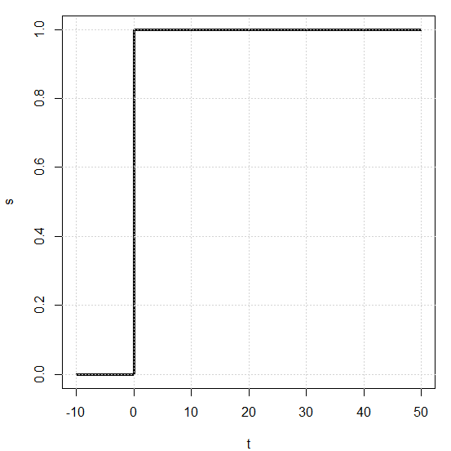
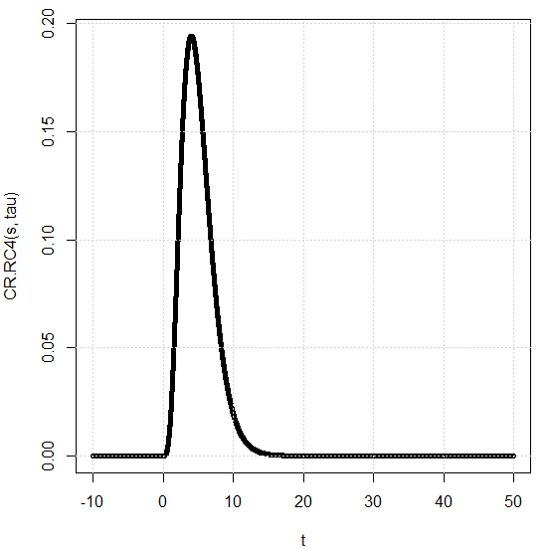
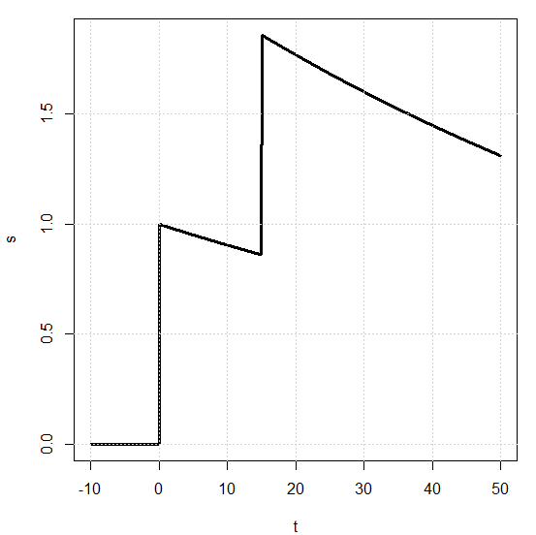
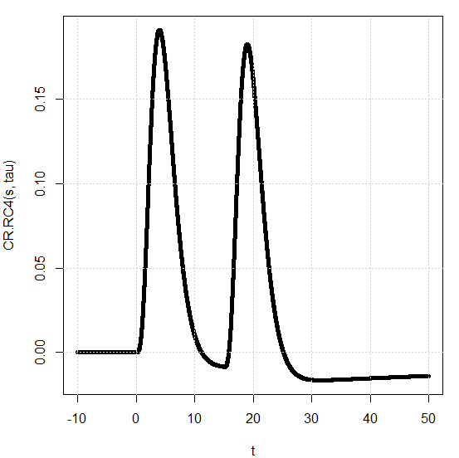
A complete DIY numerical shaper…
… from scratch!
Nice, but CSP output IS NOT a step…
→ It is an exponential whose time constant depends on CSPs
components feedback (RfCf)
Ok
Nok!
Same amplitude
= same charge

Slide 18
A complete DIY numerical shaper…
… from scratch!
We would like to do that :
But we did this :
$$\frac{Q}{Cf}∙\frac{1}{p}∙\frac{τ∙p}{{\left(1+τ∙p\right)}^{5}}$$
$$\frac{Q}{Cf}∙\frac{τ_{csp}}{1+τ_{csp}∙p}∙\frac{τ∙p}{{\left(1+τ∙p\right)}^{5}}$$
CSP
Shaper
CSP
Shaper
In fact, the transfer function of the shaper should rather look like:
$$\frac{Q}{Cf}∙\frac{τ_{csp}}{1+τ_{csp}∙p}∙\frac{1}{τ_{adj}}∙\frac{1+τ_{adj}∙p}{{\left(1+τ∙p\right)}^{5}}$$
This is the pole/zero corrector
of your favorite shaper.
By adjusting τadj, you cancel out
the preamp response.
CSP
Shaper

Slide 19
A complete DIY numerical shaper…
… from scratch!
Please, write the ARMA model of the PZ corrector
$$\frac{b_{0}+b_{1}∙z^{−1}+…+b_{n}∙z^{−n}}{a_{0}+a_{1}∙z^{−1}+…+a∙z^{−n}}$$
$$1+τ_{adj}∙p$$
$$p→\frac{1}{Ts}∙\left(1−z^{−1}\right)$$
$$\left[b_{0},b_{1},…,b_{n}\right]=???$$
$$\left[a_{0},a_{1},…,a_{n}\right]=???$$

Slide 20
A complete DIY numerical shaper…
… from scratch!
The R code :
CR.RC4 <- function (s, tau, pz.adj) {
my.PZ <- Arma (b = c(1+pz.adj / dt, -pz.adj / dt),
a = 1)
dummy <- filter (my.PZ, s) / pz.adj
my.LP <- Arma (b = 1,
a = c(1+tau/dt, -tau/dt))
dummy <- filter (my.LP, dummy)
dummy <- filter (my.LP, dummy)
dummy <- filter (my.LP, dummy)
dummy <- filter (my.LP, dummy)
filter (my.LP, dummy)
}

Slide 21
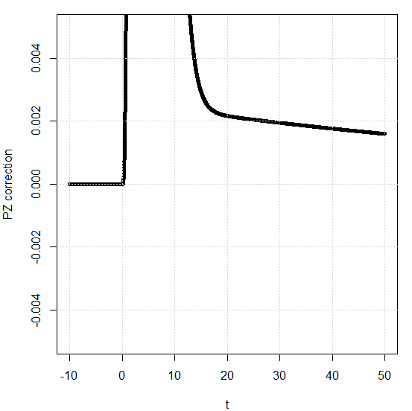
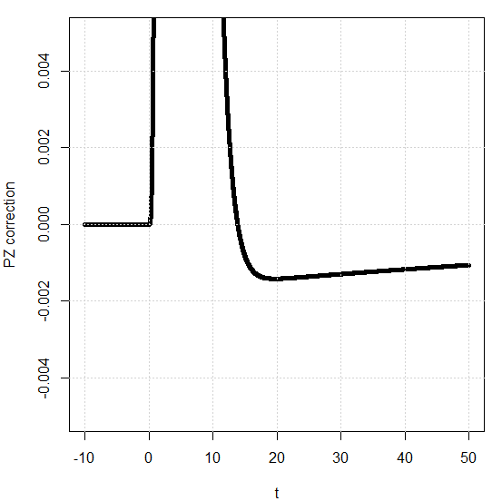
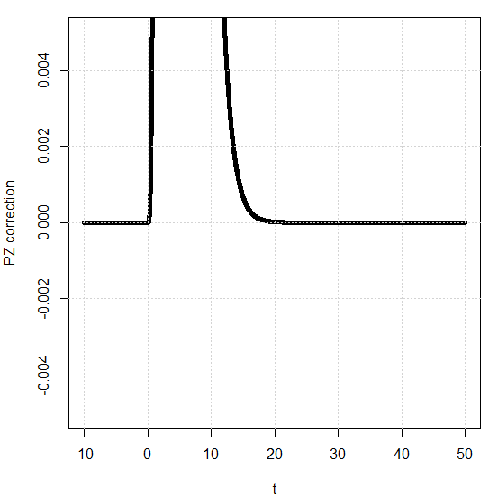
A complete DIY numerical shaper…
… from scratch!
We have to adjust PZ corrector to preamp. output:
Have a careful look at the baseline :
Pz.adj = 80
Not good…
Pz.adj = 120
oups, to much…
Perfect! Don’t touch anymore →
Pz.adj = 100

Slide 22
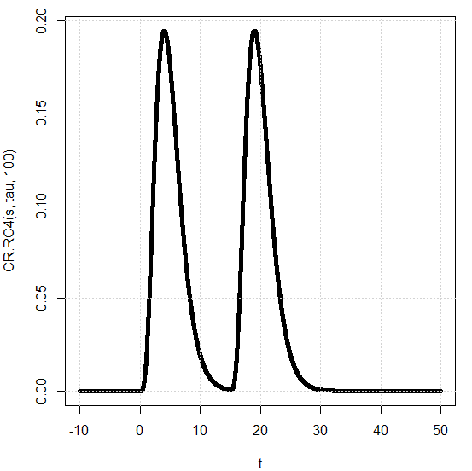
A complete DIY numerical shaper…
… from scratch!
And, this time, everything goes right!
Ok
This complete the filtering section of the shaper.
YES, YOU did it!

Slide 23
A complete DIY numerical shaper…
… from scratch!
Alas, this new shaper let pass slowly varying baseline fluctuations…
Stop for now!
We should add a baseline restorer to complete our shaper
in order to have a good shaper. Here, it doesn’t matter.
Let’s play with our new toy!
We corrected the CSP PZ.
What would happen if we play with the shaping time?

Slide 24
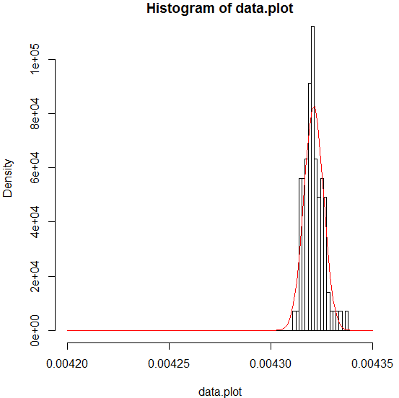
A complete DIY numerical shaper…
… from scratch!
Shaping time adjust
We build an histogram of data (deposited energy = 1MeV in Si)
And we measure its standard deviation…
Shaping time = 1µs
Mean = 0.00432
Sd = 4.8e-6
resolution = 1.1keV
… for each shaping
time…

Slide 25
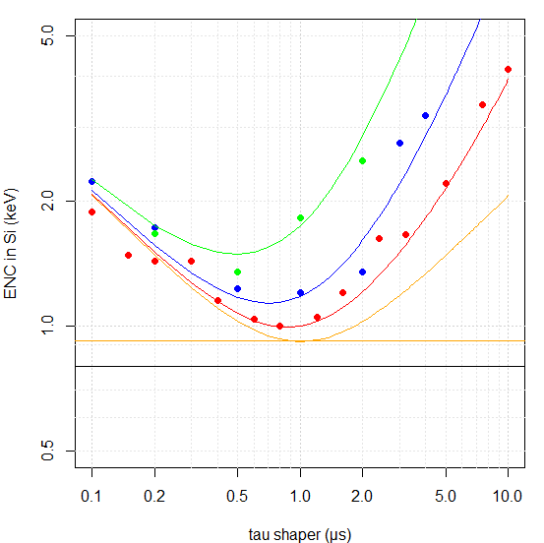
A complete DIY numerical shaper…
… from scratch!
count rate = 100k c/s
Shaping time adjust
count rate = 40k c/s
count rate = 10k c/s
Resolution depends on
Shaping time
Counting rate
Our CR-RC4
@ count rate = 0
CR-RC4 @opt shaping
Optimal filter

Slide 26
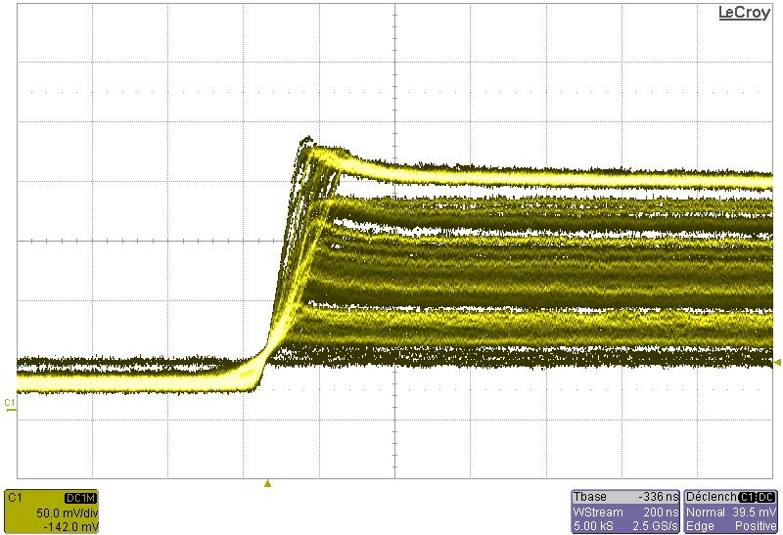
A complete DIY numerical shaper…
… from scratch!
Shaping time adjust…
… depends also on ballistic deficit → see trapezoidal filter
HP Ge
200ns
662keV

Slide 27
A complete DIY numerical shaper…
… from scratch!
YOU DID IT!
In fact, difficulties arise when trying to implement the filter
on limited computational abilities devices (FPGA)
There is always an optimal shaping time
This optimal shaping time depends on
Your detector/preamp.
The counting rate
The deficit balistic
That’s all folks!

