Slide 1
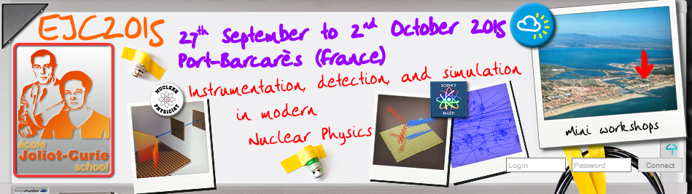

Fundamentals of
Nuclear Instrumentation
J-M Fontbonne / LPC Caen
fontbonne@lpccaen.in2p3.fr

Slide 2
Introduction
Nuclear Instrumentation…
what is it? Or not…
A simple view
physics
detectors
electronics
DAQ
that implies
Prop. Counters
TPCs
Triggers
MPPCs
PM tubes
Preamplifiers
GEMs
ICs
Coïncidence units
scintillators
APDs
QDCs
MWPCs
µchannel plates
Shaping amplifiers
PPACs
STOP! I’m sure to forget something…
TDCs
ADCs

Slide 3
Introduction
Nuclear Instrumentation…
what it should be (I think)!
A more elaborate one… The knowledge driven point of view:
The physics
we know
Physics Φ
Transport Φ
Prop. Counters
TPCs
Triggers
MPPCs
PM tubes
GEMs
Preamplifiers
scintillators
ICs
Coïncidence units
APDs
MWPCs
QDCs
Signal Processing Φ
µchannel plates
PPACs
Shaping amplifiers
TDCs
ADCs
examples
The physics
we search
Data analysis Φ
This way, Your knowledge will apply to all kind of
detectors, electronics, and even problem…

Slide 4
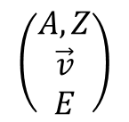
Introduction
Nuclear Instrumentation…
The physical phase:
What kind of knowledges?
$$\left(\begin{matrix}A,Z \\ \vec{v} \\ E\end{matrix}\right)$$
Basic particles
properties
Energy deposition process :
Excitation → light
Ionization → charges
Heat → heat…
Physics Φ
Radiation matter interaction
Materials properties
Special focus on :
Light (scintillators)
Charges (solid or
gaseous detectors)
What types of quanta?
Where?
When?
Quanta
description

Slide 5
Introduction
Nuclear Instrumentation…
The transport phase:
What kind of knowledges?
What kind of quanta?
Where?
When?
Quanta
description
Special focus on :
Electrostatics & detectors
design
Signal induction
  → Ramo-Shockley Theorem
Transport Φ
Light transport (optics),
Charge transport in matter (electrostatics)
Signal induction (electrostatics)
Current
description
i(t)

Slide 6
Introduction
Nuclear Instrumentation…
The signal processing phase:
What kind of knowledges?
Current
description
i(t)
Special focus on :
Digital signal processing
Optimal filtering
Signal Processing Φ
Basics electronics
Noise characterization
Signal processing
Charge measurement
Time measurement
Signal measurement
Data
acquisition

Slide 7
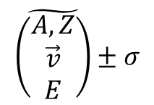
Introduction
Nuclear Instrumentation…
The data analysis phase:
What kind of knowledges?
Charge measurement
Time measurement
Signal measurement
Data
acquisition
Special focus on :
Uncertainties measurement
& combination
Data analysis Φ
Bayesian statistics
Uncertainties combination
fitting
$$\tilde{\left(\begin{matrix}A,Z \\ \vec{v} \\ E\end{matrix}\right)}±σ$$
Basic particles
properties

Slide 8
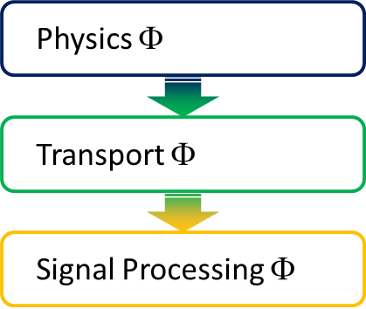
Introduction
Nuclear Instrumentation…
The complete picture:
Calibration process
→ Closes the loop…
Open loop process
The physics
we should know
The physics
we search
The physics
we measured
Our best
estimate of
Data analysis Φ
model
+
ε
experimental
parameters
-
Engineering
Physics

Slide 9
Introduction
Nuclear Instrumentation…
The complete picture:
Take it easy…
We will simplify every process to the maximum,
domain experts will hate me…
Our goal → get a complete picture of the instrumentation chain
The course will be on general subjects
But
Illustrated with specific detectors

Slide 10
Physics Φ
Transport Φ
Signal Processing Φ
Data analysis Φ

Slide 11
From particles interactions
to quanta description
scintillators
Scintillators convert deposited energy into (≈visible) light
They can be
Gaseous (N2 & CF4 scintillate pretty well)
Liquid (useful for n vs γ discrimination)
Solid
organics
fast
inorganics
Very bright
Charged particles id.
Dense, high Z (γ)

Slide 12
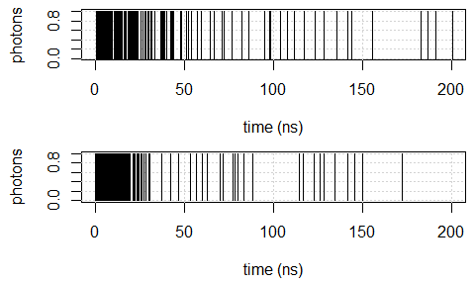
From particles interactions
to quanta description
scintillators
Every scintillator has its own response to incident particles
→ one or several decay rates,
→ various brightness's,…
But they all produce photon pulse trains:
Neutron (1MeV)
Liquid scintillator
quenching
Gamma (100keV)
About 200 Photo-Electrons (PEs)

Slide 13

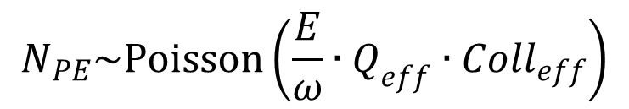
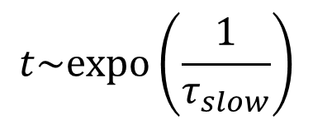
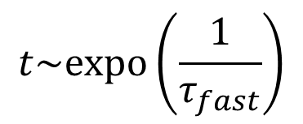

From particles interactions
to quanta description
scintillators
We will only measure PEs
First approximation:
$$N_{PE}\sim Poisson\left(\frac{E}{ω}∙Q_{eff}∙{Coll}_{eff}\right)$$
Light collection efficiency
Quantum efficiency
Energy imparted to create a photon (a few tens of eV)
$$t\sim expo\left(\frac{1}{τ_{fast}}\right)$$
$$N_{fast}\sim binom\left(N_{PE},fast prob\right)$$
discrimination
Scintillator decay time
$$t\sim expo\left(\frac{1}{τ_{slow}}\right)$$
$$N_{slow}=N_{PE}−N_{fast}$$

Slide 14

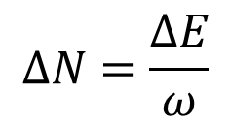
From particles interactions
to quanta description
Solid or gaseous detectors
When measuring charges, quanta are… charges
electrons/holes pairs in solid detectors
electrons/ions pairs in gaseous detectors
ω≈
25eV in gas
5eV in diamond
3,6eV in Silicon
3eV in Germanium
$$∆N=\frac{∆E}{ω}$$
A subtle process, in fact…
F≈
0.2 in gas
0.08 in diamond
0.12 in Silicon
0.13 in Germanium
$$σ_{∆N}^{2}=F∙∆N$$

Slide 15
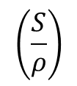
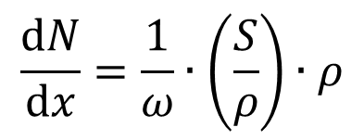
From particles interactions
to quanta description
Solid or gaseous detectors
For a finer description:
Material density (g.cm⁻³)
$$\frac{dN}{dx}=\frac{1}{ω}∙\left(\frac{S}{ρ}\right)∙ρ$$
Mass stopping power (Mev.cm².g⁻¹)
$$\left(\frac{S}{ρ}\right)$$
For electrons (at high energy)
≈2MeV.cm².g⁻¹

Slide 16
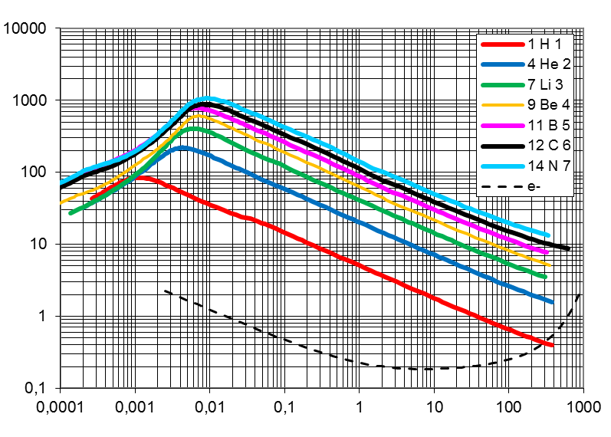

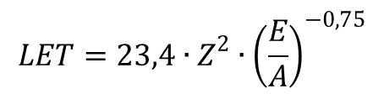
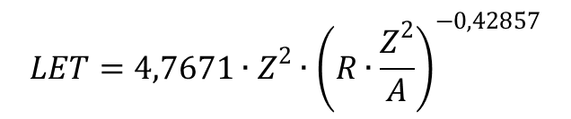
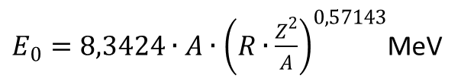
From particles interactions
to quanta description
Solid or gaseous detectors
energy loss (in water!!!)
It is often useful to have simple expressions of E, R, LET
$R=0,02442∙\frac{A}{Z^{2}}∙{\left(\frac{E_{0}}{A}\right)}^{1,75}$mm
$E_{0}=8,3424∙A∙{\left(R∙\frac{Z^{2}}{A}\right)}^{0,57143}$MeV
Linear Energy Transfer in water (KeV/µm)
$$LET=4,7671∙Z^{2}∙{\left(R∙\frac{Z^{2}}{A}\right)}^{−0,42857}$$
keV.µm⁻¹
$$LET=23,4∙Z^{2}∙{\left(\frac{E}{A}\right)}^{−0,75}$$
keV.µm⁻¹
Range in water (mm)

Slide 17
From particles interactions
to quanta description
Solid or gaseous detectors and
scintillators
We completed the first part of our problem
Depending on our
medium
Produced
quanta are
At time
And to measure them,
We will need
Scintillators
light
Solid or gaseous
charges
Random emission time
Synchronous production
photodetectors
Direct use

Slide 18
From particles interactions
to quanta description
Time for an example
Telescope? You said telescope?
How to easily simulate
a photodetector response

Slide 19
Physics Φ
Transport Φ
Signal Processing Φ
Data analysis Φ

Slide 20




From quanta description
to current description
Charged particles transport…
The story of secondary particles
Charges drift in the electric field
$$\vec{M}\left(t\right)=f\left(\vec{E}\right)$$
They diffuse by collisions on atoms
$$\vec{M}\left(t\right)=f\left(\vec{E}\right)+\vec{σ}\left(t\right)$$
They can be trapped or can recombine
$$e_{−}+M_{+}→M$$
They can ionize
$$e_{−}+M→M_{+}+e_{−}+e_{−}$$
… before being neutralized (at the electrodes or by recombination)

Slide 21
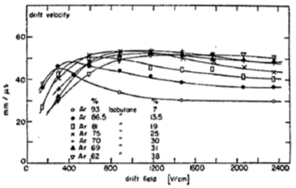
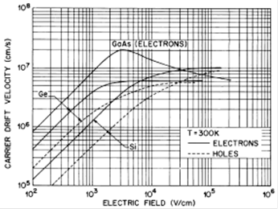

From quanta description
to current description
Charged particles transport…
trajectory
velocity (mm.µs⁻¹)
Mobility (mm².V⁻¹.µs⁻¹)
electric field (V.mm⁻¹)
(-) Electrons
(+) Holes / ions
$$\vec{v}=μ\left(E\right)∙\vec{E}$$
40µm.ns⁻¹
40mm.µs⁻¹
100V.mm⁻¹
100V.mm⁻¹
In gaseous detectors, ions mobility is constant and very low ≈[0.5,5] cm²/V/s
→we will need to find ways to cancel it out

Slide 22
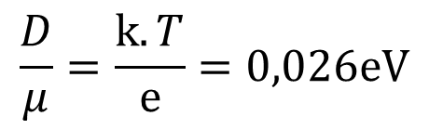



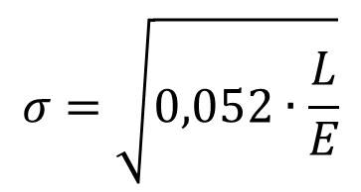
From quanta description
to current description
Charged particles transport…
diffusion
Diffusion coefficient (mm².µs⁻¹)
By definition:
$$σ=\sqrt{2∙D∙t}$$
Standard deviation of charges cloud (mm)
$$\frac{D}{μ}=\frac{k.T}{e}=0,026eV$$
Einstein’s contribution to diffusion’s law:
$$σ=\sqrt{0,052∙\frac{L}{E}}$$
Practical consequence:
$$E=1kV.{cm}^{−1}$$
Travel length (mm)
σ=230µm
$$L=10cm$$

Slide 23
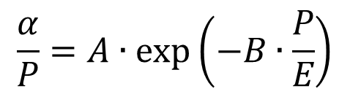

From quanta description
to current description
Charged particles transport…
multiplication & gain
Avalanche gain:
$$N=N_{0}∙\exp\left(α∙L\right)$$
with
$$\frac{α}{P}=A∙\exp\left(−B∙\frac{P}{E}\right)$$
α≈18.75cm⁻¹
Strong electric field
(near wires for instance)
E≈28kV.cm⁻¹
Patm=750Torr

Slide 24
From quanta description
to current description
At this point…
We have all the parameters governing the charges transport
→ it’s your concern to get them
if you want to simulate your detector
in the literature, or by measurement
Mobility → mandatory
Diffusion → if secondaries make long drives (say 10cm or more)
Amplification → if any in your detector
Next step, the electric field

Slide 25

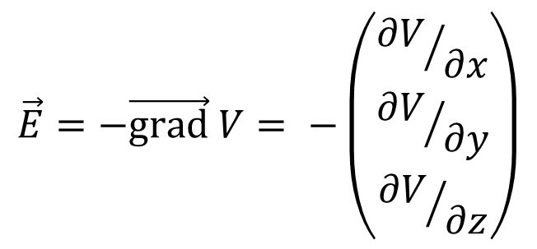
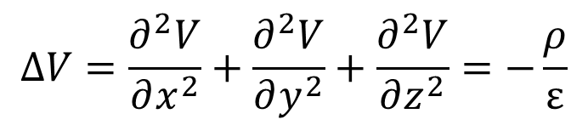
From quanta description
to current description
Detector’s electric field…
that’s what wee need at least!
Space charge (C.mm⁻³)
Compute once:
$$∆V=\frac{∂^{2}V}{∂x^{2}}+\frac{∂^{2}V}{∂y^{2}}+\frac{∂^{2}V}{∂z^{2}}=−\frac{ρ}{ε}$$
❶ :
Easy to compute (or not)…
$$\vec{E}=−\vec{grad} V= −\left(\begin{matrix}{∂V}/{∂x} \\ {∂V}/{∂y} \\ {∂V}/{∂z}\end{matrix}\right)$$
❷ :
… from which we derive electric field
ε _{r}≈
1 in gas
5.7 in diamond
11.9 in Silicon
16 in Germanium
4 in PCB
Beware : space charge created by secondaries can change
the electric field strength

Slide 26



From quanta description
to current description
that’s what wee need at least!
I order to propagate secondaries
For each secondary:
① :
$$\vec{v}=μ\left(E\right)∙\vec{E}$$
… compute “secondaries” velocity
② :
$$dN=N∙α∙\left|v\right|∙dt$$
… add charges created by avalanche
③ :
$$d\vec{M}=\vec{v}∙dt±\sqrt{2∙D∙dt}$$
… and “secondaries” trajectory
Loop until charges collection (/ recombination / trapping → not included here)
If space charge is important, compute electric field at each step…
We can do that analytically (difficult), by numerical integration (easy) or by MC (long)

Slide 27
From quanta description
to current description
At this point…
We are now able to transport our charges in our specific detector.
Next step, signal induction

Slide 28



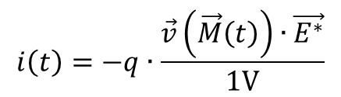

From quanta description
to current description
Ramo-Shocley Theorem
the final step
Ramo-Shockley theorem is a consequence of electrostatics laws.
It tells us that:
$$\vec{v}\left(\vec{M}\left(t\right)\right)$$
If a particle of charge is traveling at velocity in a detector
$$q$$
Then, the induced* current on the measurement electrode is :
$$i\left(t\right)$$
$$i\left(t\right)=−q∙\frac{\vec{v}\left(\vec{M}\left(t\right)\right)∙\vec{E^{∗}}}{1V}$$
$$\vec{E^{∗}}$$
Where, , the virtual field is the field that WOULD exist if we…
Removed all space charges
Put 1V on the measurement electrode (at fixed potential)
Put 0V on all other electrodes (whatever their fixed potential)
* Induced current = current generator injected in the measurement electrode

Slide 29
From quanta description
to current description
Current description step by step.
⓿ : where, how many & when secondary particles were created?
❶ : compute the electric field of your detector
❷ : transport your secondaries in the electric field
① : compute Ramo’s virtual field
② : compute resulting current generator induced in your detector
on measuring electrodes
… time for examples?

Slide 30
From quanta description
to current description
Ramo-Shocley Theorem…
the cookbook
HpGe in planar configuration
Measuring electrons capture
In the air

Slide 31
From quanta description
to current description
Ramo-Shocley Theorem…
the cookbook
Nuclear detectors are current generators (also known as
high impedance sensors)
We know how to compute the current induced
by an incident particle (just follow the cookbook!)
Direct conversion sensors
No gain
Auto-amplified sensors
Internal gain
Qmeas = Qdep
Qmeas = Qdep x Gain
Beware to noise…
Pay att. to gain process
Two families :
We will have to learn HOW to process these
current generators…
For the moment, let’s try to understand some tricks of
high-impedance sensors…

Slide 32
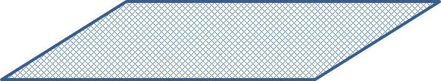
From quanta description
to current description
Detectors model
We are now able to express
Ramo’s current generators on
every electrode (supposed at fixed
potential) of our system,
whatever its complexity…
Not bad, but, it’s just the beginning
of the story…

Slide 33
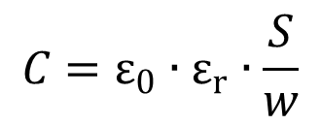
From quanta description
to current description
Detectors model
We have to add capacitances
between electrodes
and from electrodes to ground
For instance :
Vacuum permittivity = 8.8pF.m⁻¹
Relative permittivity [1..12]
Electrodes surface
$$C=ε_{0}∙ε_{r}∙\frac{S}{w}$$
Electrodes distance

Slide 34
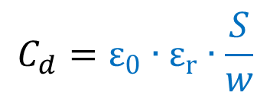
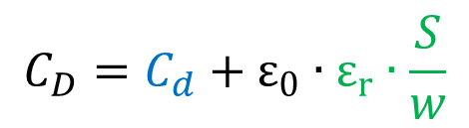
From quanta description
to current description
Detectors model
Parasitic capacitances can ruin your best design!!!
gas
$$C_{d}=ε_{0}∙ε_{r}∙\frac{S}{w}$$
5mm
17.6pF
10cm
$$C_{D}=C_{d}+ε_{0}∙ε_{r}∙\frac{S}{w}$$
PCB, ε_{r} ≈4
17.6pF
31.0pF
1cm
Surface used to glue electrodes to PCB

Slide 35

From quanta description
to current description
Detectors model
And cables are dangerous friends…
… when loaded at high impedance
gas
$$C_{d}=ε_{0}∙ε_{r}∙\frac{S}{w}$$
5mm
17.6pF
10cm
$$C_{D}=C_{d}+Lc∗100pF.m^{−1}$$
17.6pF
50.0pF
to high impedance load
(oscilloscope or charge preamplifier)
Lc=50cm

Slide 36
From quanta description
to current description
When designing a detector…
Parasitic capacitances can ruin your best design!!!
It is your responsibility to reduce parasitic capacitances
And cables are dangerous friends…
… when loaded at high impedance
If detector is not self-amplified (no avalanche), we usually
need to connect it to a Charge Sensing Preamp. (High Z)
The cable connecting detector to CSP is “seen” as
a capacitance whose value is 100pF/m.
When connected to a 50Ω load, a line receiver preamp.,
the cable is “transparent”.

Slide 37
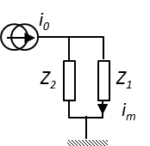
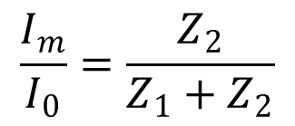
From quanta description
to current description
Why reduce de capacitances?
-1- a general view of the problem
Playing with current generators…
Every electronics can be simply
Represented by an impedance
$$\frac{I_{m}}{I_{0}}=\frac{Z_{2}}{Z_{1}+Z_{2}}$$
Other detector impedances
Our electronics (preamplifier for instance)
We need the current flow thru our electronics
We shall provide a Low impedance path Z1 << Z2
Other impedances (polarisation, filtration…) should
  be great enough!

Slide 38
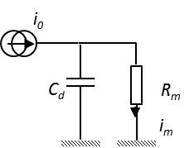


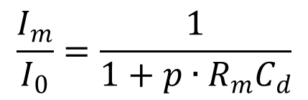
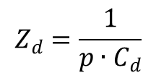
From quanta description
to current description
Why reduce de capacitances?
-2- they are low impedance path’s
Playing with current generators…
Transfer function
$$Z_{m}=R_{m}$$
$$\frac{I_{m}}{I_{0}}=\frac{1}{1+p∙R_{m}C_{d}}$$
$$Z_{d}=\frac{1}{p∙C_{d}}$$
P ← Laplace formalism
This is a 1st order low pass filter (LPF)
$$R_{m}C_{d}$$
Is the “time constant” of our filter…
Example: Rm=50Ω, Cd=20pF → 1ns

Slide 39

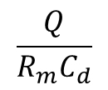
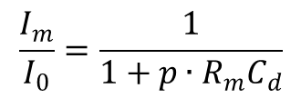



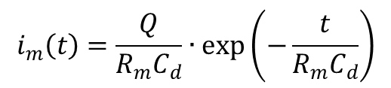

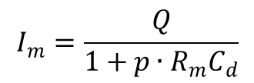



From quanta description
to current description
Why reduce de capacitances?
-2- they are low impedance path’s
Playing with current generators… and Laplace transform
Pulse response of a 1st order LPF:
$$i_{m}\left(t\right)=\frac{Q}{R_{m}C_{d}}∙\exp\left(−\frac{t}{R_{m}C_{d}}\right)$$
$$i_{0}\left(t\right)=Q∙δ\left(t=0\right)$$
$$ℒ$$
$$ℒ^{−1}$$
$$\frac{I_{m}}{I_{0}}=\frac{1}{1+p∙R_{m}C_{d}}$$
$$I_{m}=\frac{Q}{1+p∙R_{m}C_{d}}$$
$$I_{0}=Q$$
$$i_{0}\left(t\right)$$
$$i_{m}\left(t\right)$$
$$Q$$
$$Q$$
$$\frac{Q}{R_{m}C_{d}}$$
LPFs don’t affect total charge

Slide 40
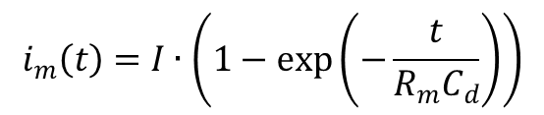



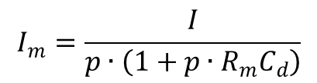
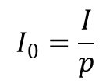
From quanta description
to current description
Why reduce de capacitances?
-2- they are low impedance path’s
Playing with current generators… and Laplace transform
Step response of a 1st order LPF:
$$i_{m}\left(t\right)=I∙\left(1−exp\left(−\frac{t}{R_{m}C_{d}}\right)\right)$$
$$i_{0}\left(t\right)=I∙H\left(t=0\right)$$
$$ℒ$$
$$ℒ^{−1}$$
$$I_{0}=\frac{I}{p}$$
$$\frac{I_{m}}{I_{0}}=\frac{1}{1+p∙R_{m}C_{d}}$$
$$I_{m}=\frac{I}{p∙\left(1+p∙R_{m}C_{d}\right)}$$
$$i_{0}\left(t\right)$$
$$i_{m}\left(t\right)$$
$$I$$
$$I$$

Slide 41
From quanta description
to current description
Why reduce de capacitances?
-3- they amplify noise
All that was said is absolutely true in the general case:
→Simple detector’s aspects affect the current we should observe
But there is one more issue for low noise designs :
→ Measurement uncertainty relies on Cd
But it’s too soon… We will understand why later

Slide 42
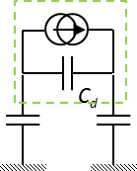
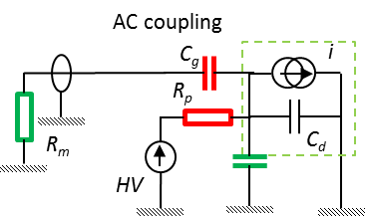
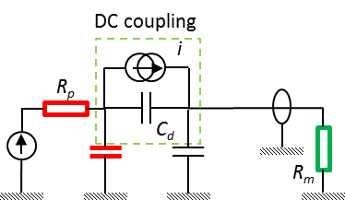
From quanta description
to current description
Detector model
the complete picture:
Playing with current generators…
❷
❶
For the moment, our detector is simply…
We need
to extract signal from point ❶ or ❷
to put HV at point ❷
to cancel out current generator of ❷ or ❶
All these parasitic
capacitances should be as SMALL as possible
i
i
As LARGE as possible (nF, MΩ)
As SMALL as possible (pF, Ω)

Slide 43
From quanta description
to current description
Detector model
the complete picture:
We know the current generator for any detector configuration
We know how to polarize the detector and
properly extract the signal
PM signals quantification.
…Toward a good methodology
We know that we shall minimize parasitic capacitances
and pay attention to detector capacitance

Slide 44
Physics Φ
Transport Φ
Signal Processing Φ
Data analysis Φ

Slide 45
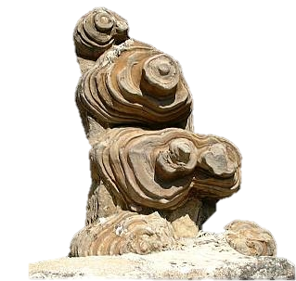
From current description
to data acquisition
It would be logical, but…
Uncertainties specification is often the stumbling block
for young scientists…
but it’s the right way for good scientists…
And, above all, it helps…
… so we will jump to this section
& come back later
La pierre d’achoppement du
du Facteur Cheval

Slide 46
Physics Φ
Transport Φ
Signal Processing Φ
Data analysis Φ

Slide 47

From data acquisition
to uncertainties
The Bayesian point of view…
Believe me, every scientist is Bayesian…
… and Bayes formalism helps us to clarify hypothesis & conclusions
So, why not having a look to this subject?
The basics:
We have data.
We should be able to express a (statistical) model of these data
,so it easy to write (also known as likelihood)
$$P\left(data \right| model, parameters)$$
Reads probability of data, knowing the model and its parameters

Slide 48
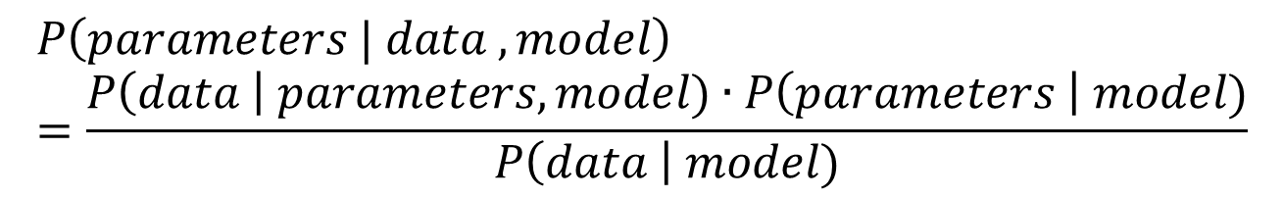
From data acquisition
to uncertainties
The Bayesian point of view…
Bayes Theorem… :
Posterior parameters probability
likelihood
Prior parameters probability
$$P\left(parameters | data , model\right)=\frac{P\left(data \right| parameters, model)∙P\left(parameters \right| model)}{P\left(data \right| model)}$$
Bayes factor
= constant for a given model
… is an efficient way to go from statistician’s point of view to
physicist’s point of view!
But sometimes hard to apply.

Slide 49
From data acquisition
to uncertainties
How can it help us?
Bayes formalism explain HOW to analyze our data
GIVEN our knowledge of underlying assumptions
Basic problems, data not correlated, Gaussian noise
Simple curve fitting
Least square
Intermediate problems, data are correlated, Gaussian noise
Electronics noise & signal analysis, …
Chi2
Increasing complexity
complex problems, data are correlated, non Normal distributions
Counting, pulse shaping, …
Maximum likelihood
Very complex problems, data are correlated, non Normal distributions,
we have a priori about parameters distributions
Uncertainties combination, physics, …
MC

Slide 50
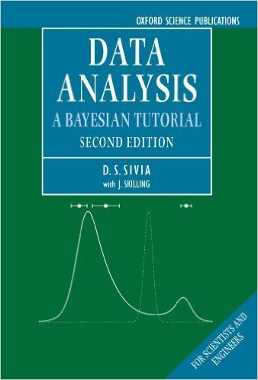
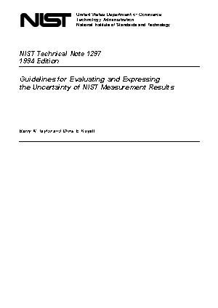

From data acquisition
to uncertainties
Good literature
A wonderful (clear) introduction (and far more)
To Bayesian Data Analysis
Cheap: 40€ !
“Everything You Always Wanted to Know
About Uncertainties* But Were Afraid to Ask”
For free!
* Sorry Woody…

Slide 51

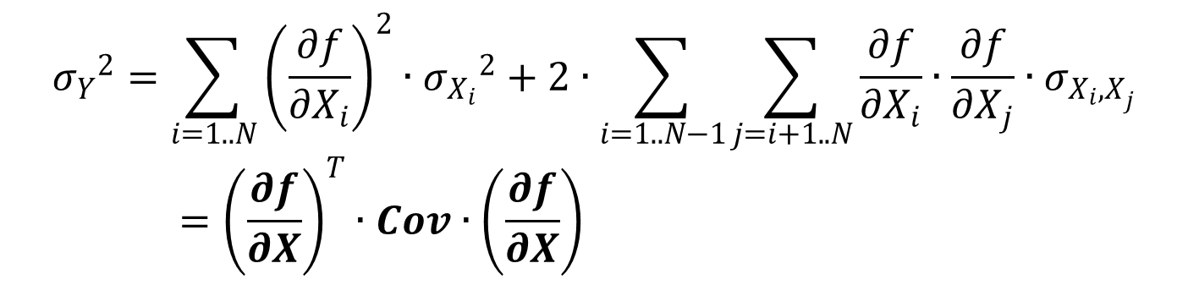
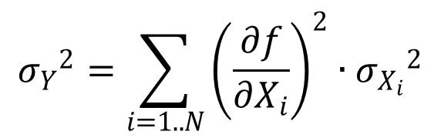
From data acquisition
to uncertainties
A focus on uncertainties combination
The result we need
Our model
$$Y=f\left(X_{1},X_{2}, …X_{N}\right)$$
The data we acquired
And their uncertainties
$${σ_{Y}}^{2}=\sum_{i=1..N}{{\left(\frac{∂f}{∂X_{i}}\right)}^{2}∙{σ_{X_{i}}}^{2}}+2∙\sum_{i=1..N−1}{\sum_{j=i+1..N}{\frac{∂f}{∂X_{i}}∙\frac{∂f}{∂X_{j}}∙σ_{X_{i}{,X}_{j}}}}={\left(\frac{∂f}{∂X}\right)}^{T}∙Cov∙\left(\frac{∂f}{∂X}\right)$$
Its uncertainty
$${σ_{Y}}^{2}=\sum_{i=1..N}{{\left(\frac{∂f}{∂X_{i}}\right)}^{2}∙{σ_{X_{i}}}^{2}}$$
… If data are not correlated

Slide 52
From data acquisition
to uncertainties
Time for an example ?
We only combine variances (i.e. standard deviation squared)
never use FWHM or PKtoPK !!!
only RMS
If variance is known (evaluated or known) → type A uncertainty
If variance is estimated (prior knowledge) → type B uncertainty
Neutron energy measurement
by Time Of Flight (TOF)
Uncertainty in light measurements

Slide 53
Physics Φ
Transport Φ
Signal Processing Φ
Data analysis Φ

Slide 54
From current description
to data acquisition
Now, it’s time!
just a look at signal
Remember :
Scintillators
light
Solid or gaseous
charges
Random emission time
Synchronous production
photodetectors
Direct use
Random
shape
Continuous
shape
Direct conversion sensors
No gain
Auto-amplified sensors
Internal gain
Qmeas = Qdep
Qmeas = Qdep x Gain
Beware to noise…
Pay att. to gain process
large
4 kinds
of signals
small

Slide 55
From current description
to data acquisition
Now, it’s time!
just a look at signal
Remember :
Random
shape
Continuous
shape
Signal shape →
Signal amplitude↓
large
Scintillators
+ PM, MPPC, APD
Gaseous amplified
MWPC, PPAC, PC,
GEM, …
Pay attention to gain
(Line receiver preamp)
+ Charge meas. (QDC)
Or…
Scintillators
+ PD
Solid Si, HpGe
Gaseous IC
small
Take care of noise!
Charges preamps
+ shaping amplifier
+ peak-hold (ADC)

Slide 56
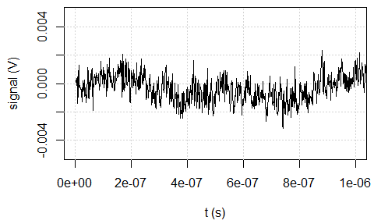
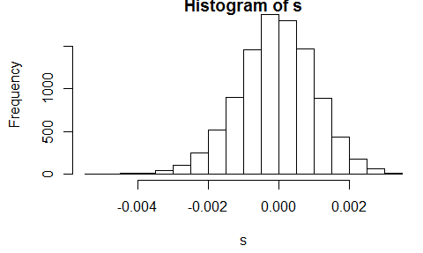


From current description
to data acquisition
How to describe noise?
In the time domain, it’s very hard…
In fact, it is possible (use the covariance)
σ=1.2mV_{RMS}
Switch to frequency domain → noise spectral density S(f) [V²/Hz]
It is related to components value and to the transfer function of the whole system
Noise is not
always white!!!
$$σ^{2}=\int_{0}^{∞}{S\left(f\right)∙df}$$

Slide 57





From current description
to data acquisition
To see the specific nature of your noise
→ switch to frequency domain
Oscilloscope or digitizer
Line receiver gain=100, BW=50MHz
Charges Sensing Preamp.
OUPS…

Slide 58
From current description
to data acquisition
Now, it’s time!
and, what about noise?
Every time we connect an electronics component* (resistors,
transistors, OpAmps, …), we add a noise source…
The basic ideas :
add the less possible components around the detector
some are necessary (preamp., HV resistor)
→ they have to be selected according their noise properties
Pre-amplify the signal in order to get out of noise floor
→let it do what it wants, in accordance to previous point
Correct the preamp. ouput in order to do what you want,
not what it did!
* Except capacitors

Slide 59

From current description
to data acquisition
For instance, signal & noise
after a Charge Sensing Preamp:
The perfect illustration
of the concept
In fact, good CSP are not OpAmp
(no + input required)
The feedback (=gain)
→ A capacitance = NO NOISE
Mandatory : we are building a detector!
Mandatory : we need a preamplifier!
The only noise source we added
The feedback resistance. We will need to
select it carefully
Cables are dangerous…
No impedance matching → cable = capacitance (100pF/m)

Slide 60


From current description
to data acquisition
For instance, signal & noise
first, signal:
Signal after the CSP :
Pulse response :
$$v_{csp}\left(t\right)=\frac{Q}{C_{f}}∙\exp\left(−\frac{t}{R_{f}C_{f}}\right)$$
This is a good news, peak amplitude is prop. to the charge…
But remember, that was not our primary goal…
Let’s have a look at noise…

Slide 61




From current description
to data acquisition
For instance, signal & noise
second, noise:
Noise spectral density after the CSP :
$${Se}_{Csp}≈{\left|\frac{1}{{2π∙f∙C}_{f}}\right|}^{2}∙Si+{\left|1+\frac{C_{d}}{C_{f}}\right|}^{2}∙Se$$
$$Si=2e∙I_{rev}+\frac{4kT}{R_{p}}+\frac{4kT}{R_{f}}+{Si}_{OA−}$$
$$Se={Se}_{OA}$$
Rf <- 100e6 # Ohm
Cf <- 2e-12 # F
Rin <- 100e6 # W
Cin <- 10e-12 # F
Iinv <- 100e-9 # A
Si.oa <- 5e-15 # A/Hz^1/2
Se.oa <- 10e-9 # V/Hz^1/2
Aol <- 1000 # 1
fol <- 1e6 # Hz
← after CSP
← Before CSP

Slide 62



From current description
to data acquisition
For instance, signal & noise
second, noise:
Noise spectral density after the CSP :
$${Se}_{Csp}≈{\left|\frac{1}{{2π∙f∙C}_{f}}\right|}^{2}∙Si+{\left|1+\frac{C_{d}}{C_{f}}\right|}^{2}∙Se$$
$$Si=2e∙I_{rev}+\frac{4kT}{R_{p}}+\frac{4kT}{R_{f}}+{Si}_{OA−}$$
$$Se={Se}_{OA}$$
Notice that :
Both signal & noise are “amplified” by Cf → no consequence
(in fact, too large Cf decrease rise time)
Cd amplifies the voltage noise generator
Cd = detector capacitance + cable capacitance… → minimize them !!!
Several current noise generators are in //
it is generally possible to make less noise with added components
than the detector’s noise itself… → maximize Rf et Rp

Slide 63

From current description
to data acquisition
You got a headache?
take it easy…
Let’s have a look at all this stuff…
Aspirin time
Equivalent noise charge at
CSP output

Slide 64
From current description
to data acquisition
Now, I need your attention:
third, signal processing!
When signal & noise don’t share the same shape,
there is always something to do for that things get better…
→ This is optimal filtering!
This is (almost) what is done in Spectroscopy Amplifiers!
(optimal) filtering is your hope of salvation
Before trying any fashionable approach of signal processing
(neural networks, wavelet transforms, even Bayesian technics…)
You shall master optimal filtering!!!
This is the only one LINEAR technics, and IT IS OPTIMAL.

Slide 65








From current description
to data acquisition
The optimal filter for spectroscopy*
We did our best and we get:
CSP output = SA input →
SA transfer function
→ SA output
$$H_{SA}=???$$
Signal :
$$v_{csp}\left(t\right)=\frac{Q}{C_{f}}∙\exp\left(−\frac{t}{R_{f}C_{f}}\right)$$
$$v_{SA}\left(t\right)=ℒ^{−1}\left(H_{SA}∙ℒ\left(v_{csp}\left(t\right)\right)\right)$$
Noise :
$$m=\max\left(v_{SA}\left(t\right)\right)$$
$${Se}_{Csp}≈{\left|\frac{1}{{2π∙f∙C}_{f}}\right|}^{2}∙Si+{\left|1+\frac{C_{d}}{C_{f}}\right|}^{2}∙Se$$
$$σ=\sqrt{\int_{0}^{∞}{S_{csp}\left(f\right)∙{\left|H_{SA}\right|}^{2}∙df}}$$
$$H_{SA}$$
$$\frac{m}{σ}$$
Find for is maximal
*See the course full text for details
on how to compute optimal filters

Slide 66



From current description
to data acquisition
The optimal filter for spectroscopy
Doing this, we would demonstrate* that the optimal filter output of
the shaping amplifier for the signal and noise above is:
It’s called
“cusp”
/
=
Whose equivalent noise charge (ENC) is :
$$ENC=\sqrt{C_{d}∙\sqrt{Se∙Si}}$$
*See the course full text for details
on how to compute optimal filters

Slide 67


From current description
to data acquisition
The optimal filter for spectroscopy
Whatever the shaping amplifier, the ENC looks like :
$$ENC=k∙\sqrt{C_{d}∙\sqrt{Se∙Si}}$$
k=1 for the cusp filter
The lower the detector capacitance, the lower the ENC !
say for instance Cd = 10pF
If Se^{½} = 5nV/Hz^{½} (for instance) and reverse current = 1nA :
$$\frac{4∙k∙T}{2∙e∙Irev}$$
Every resistor (feedback) should be greater than = 50MΩ
ENC = 0.03fC = 187 charges = 0.7 keV_{RMS} in Si
REMEMBER, we found 7.6 keV_{RMS} in Si just at the CSP output!

Slide 68




From current description
to data acquisition
Once Hopt defined, one can play with
other filters and/or technics!
shape
ENC / ENC opt
Ballistic deficit sensitivity
CR-RC
1.36
low
The Swiss Army Knife, easy to build, cheap…
CR-RCn
Semi-gaussian
1.14
medium
State of the art in analog signal processing
trapezoidal
Flat top duration
great → null
ENC / ENC opt
1.07→1.25
State of the art in digital signal processing

Slide 69
From current description
to data acquisition
Filtering is cool!
Now, It’s time for DIY !
Let’s build a complete and
performant numerical spectroscopy
amplifier from scratch*…
And moreover, play with this toy!
* Yes, we can! Thx Barack…

Slide 70
From current description
to data acquisition
Filtering is cool!
as a conclusion…
In our experiments, we basically process signals
Whatever the signal, whatever the noise, there is always
an optimal filter for your specific problem
Seeking for this optimal filter helps you to understand how far
your solution is from the best possible one (even if it
is not realizable…)
n γ discrimination

Slide 71
Thank you for your attention, Now, it’s up to you! Close the loop!!!
Physics Φ
Transport Φ
Signal Processing Φ
Data analysis Φ
Well, we did it… But there is a lot to say more.
We didn’t talk about timing & localization for instance.
→ Have a look at the course full text edition*!
* Coming soon

