Slide 1
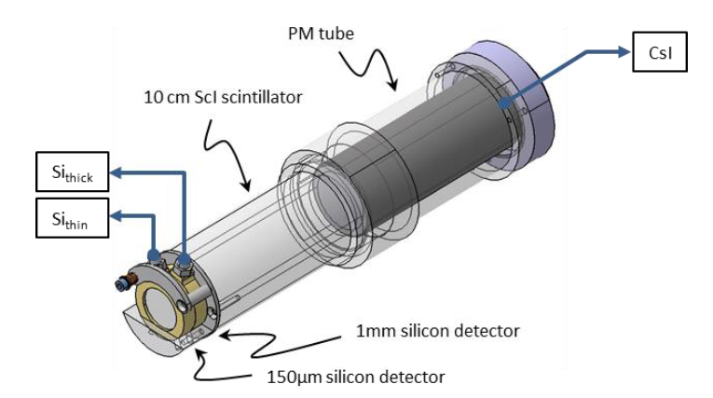
Telescope measurements
In nuclear physics, a “telescope”… is not a telescope!
It is an assembly of two or more detectors
that helps identifying particles mass and charge.
It is a powerful tool !!!

Slide 2
Telescope measurements
It’s principle (here, a three stage telescope, Si, Si, CsI) :
Unknown incident particle
E CsI
E Thick
identification
E Thin

Slide 3
Telescope measurements
* here, the material is… water
sorry
Let see how it runs on a two stage telescope:
We simulate it with R:
R <- function (E, A, Z) 0.02442 * A / Z^2 * (E / A)^1.75
E <- function (R, A, Z) 8.3424 * A * (R * Z^2 / A)^0.57143
Th1 <- 0.3 #mm
Th2 <- 3 #mm
E1 <- function (E0, A, Z) {
ifelse (R(E0, A, Z) > Th1, E0 - E(R(E0, A, Z) - Th1, A, Z), E0)
}
E2 <- function (E0, A, Z) {
Er <- ifelse (R(E0, A, Z) > Th1, E(R(E0, A, Z) - Th1, A, Z), 0)
ifelse (R(Er, A, Z) > Th2, Er - E(R(Er, A, Z) - Th2, A, Z), Er)
}

Slide 4
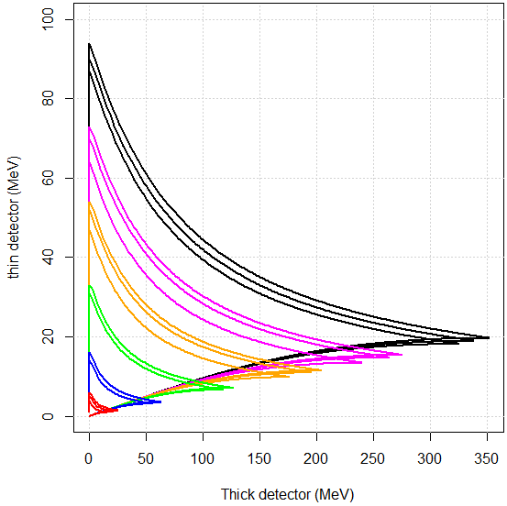
Telescope measurements
Every time a unknown particle crosses one or the two detectors,
it shall be somewhere in the (Ethick, Ethin) plot:
Here 12C beam
On PMMA target
12C
11C
10C
11B
10B
8B
10Be
9Be
7Be
7Li
6Li
4He
3He
t
d
p
Possible identification
The particle crossed
both detectors…
The particle stopped
In the first detector

Slide 5
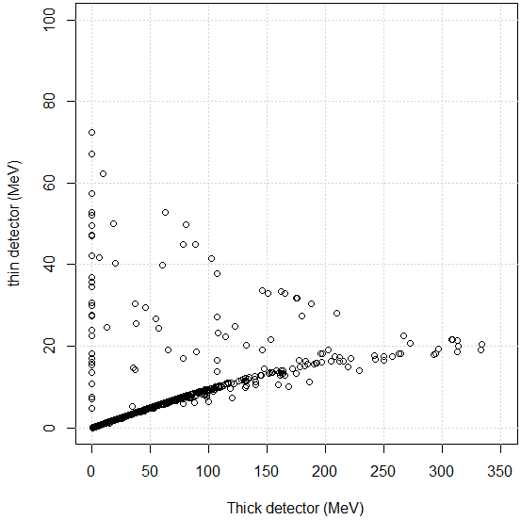
Telescope measurements
During the experiment :
Here 12C beam
On PMMA target
12C
11C
10C
11B
10B
8B
10Be
9Be
7Be
7Li
6Li
4He
3He
t
d
p
Each point correspond to
a single particle

Slide 6
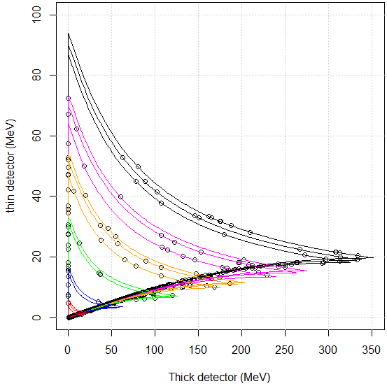
Telescope measurements
Back home:
Here 12C beam
On PMMA target
12C
11C
10C
11B
10B
8B
10Be
9Be
7Be
7Li
6Li
4He
3He
t
d
p

Slide 7
Telescope measurements
Telescopes are wonderful tools for charged particles identification
They shall be carefully designed with regard to
A, Z, E range of your specific experiment
For instance,
INDRA : IC, Si, CsI
Fragmentation : Si, Si, CsI
For new technics of identification, have a look at FAZIA!!!
That’s all folks!

