Slide 1
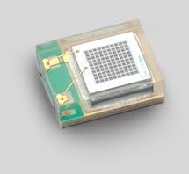
How to easily simulate
a photodetector response ?
It’s easy, in fact…
it is a hierarchical problem related to Markov chains.
2mm
We will apply the formalism to MPPCs
A MPPC is a matrix of small
Avalanche Photo-Diodes

Slide 2
How to easily simulate
a photodetector response ?
The MPPC
1. “dark count” is about 1Mcps
2. When a pixel triggers it has a probability of
say 40% to trigger one of its neighbors
3. The single P.E. response is very sharp
4. When a pixel is triggered, it refills at a given rate
say 50ns for instance
We will simulate it by using R

Slide 3
How to easily simulate
a photodetector response ?
1) Create an empty signal and its time
dt <- 0.1 # ps
t <- seq(0, by=dt, length.out=2^18) # time in ns
s <- rep(0, length(t)) # signal
We will perform a FFT later 2^N goes faster !

Slide 4
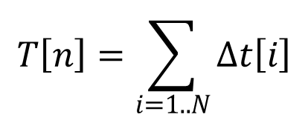
How to easily simulate
a photodetector response ?
2) Create the precursors time interval and detection time
$$T\left[n\right]=\sum_{i=1..N}{∆t\left[i\right]}$$
$$∆t\sim expo\left(count rate\right)$$
Dt <- rexp(10000, 1e6) # time intervals (in s)
T.det <- cumsum(Dt)*1e9+1000 # detection time (in ns)
T.det <- T.det[which(T.det < t[length(t)])]

Slide 5
How to easily simulate
a photodetector response ?
3) Prepare the signal of your single P.E. response
$$PE\sim normal\left(1,0.05\right)$$
PE.resp <- function () rnorm (1, 1, 0.05)

Slide 6
How to easily simulate
a photodetector response ?
4) For each precursor, prepare the secondaries
For convenience…
In fact, it is a bit more
complicated…
$$Nsec\sim Poisson\left(0.4\right)$$
Nsec <- function () rpois(1, 0.4)

Slide 7
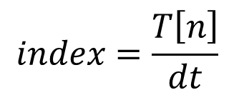
How to easily simulate
a photodetector response ?
5) For each precursor and its secondaries,
add the single P.E.s responses at right location
$$index=\frac{T\left[n\right]}{dt}$$
$$s\left[index\right]=\sum_{prec.+sec.}{P.E}$$
for (i in 1:length(T.det)) {
secondaries <- Nsec ()
index <- round(T.det[i]/dt)
for (j in 1:(1+secondaries)) s[index] <- s[index]+ PE.resp()
}

Slide 8
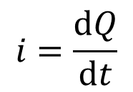
How to easily simulate
a photodetector response ?
6) Compute the detector current
$$i=\frac{dQ}{dt}$$
cur <- s * 1.6e-19 * 1e6 / (dt * 1e-9)

Slide 9
How to easily simulate
a photodetector response ?
7) The final touch, add the detector’s and electronics response
Electronics → LPF of time constant 3ns
Detector → exponential decay of time constant 50ns
el.resp <- 1/3e-9*exp(-t/3)
det.resp <- 1/50e-9*exp(-t/50)
RESP <- fft(det.resp) * fft(el.resp)
resp <- Re(fft(RESP, inverse = TRUE)) / length(t)
resp <- resp/sum(resp)

Slide 10
How to easily simulate
a photodetector response ?
8) Compute the whole response
Electronics → 50Ω load and x100 voltage gain
s.f <- 50 * 100 * Re(fft(fft(cur) * fft(resp), inverse = TRUE)) / length(t)
plot (t, s.f, type="l", xlab="time (ns)", ylab="amplitude (V)")

Slide 11
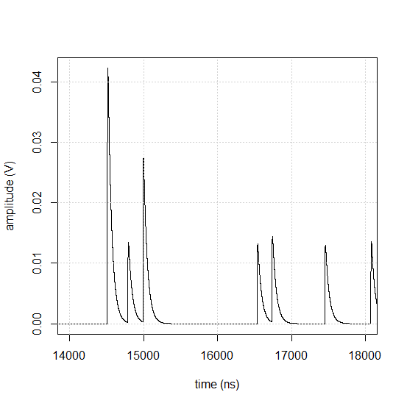
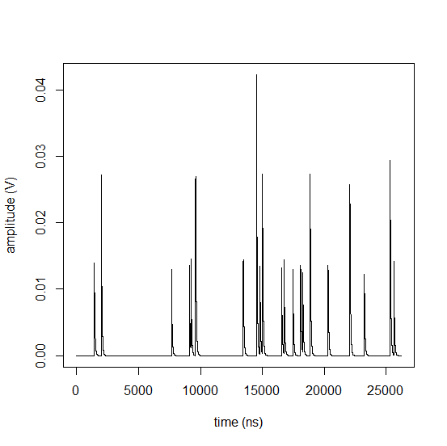
How to easily simulate
a photodetector response ?
9) Admire the result
3 P.E.
2 P.E.
1 P.E.

Slide 12
How to easily simulate
a photodetector response ?
The model is very simple, we could easily add refinements
Better model for secondaries
After pulses
Noise
…
Then we would be able to check how this signals enter
a given data acquisition system
For time measurements
Amplitude measurements
Dead time…
That’s all folks!

