Slide 1
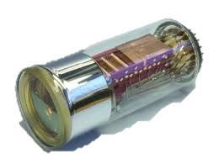
PM signals quantification.
…Toward a good methodology
A PM tube is a vacuum device
Anode
→ You get the signal there
dynodes
Amplifies the
Number of PE
Photocathode
Converts incident
Photons into
Photoelectrons (PE)
1PE → 1M electrons
3 photons → 1PE

Slide 2
PM signals quantification.
…Toward a good methodology
We bought a PM (or more plausible, found it in a cupboard…),
is it the reason to believe the constructor?
or…
How to check the gain?
or…
How to check the optical coating & coupling we took hours to do?
or…
Is it still working?

Slide 3
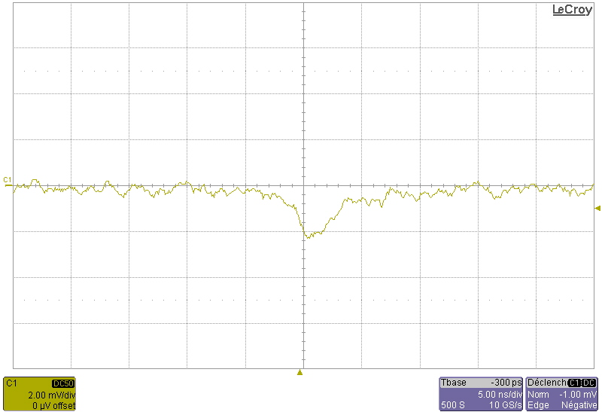
PM signals quantification.
…Toward a good methodology
PM
PM : XP2020
HT = 1650V
Single photo-electron response
Input impedance
Rload = 50Ω
The signal we see thru
the scope is completely
related to Ramo
current generator!
→ We can use it to measure some detectors properties

Slide 4


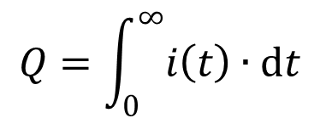

PM signals quantification.
…Toward a good methodology
From detector to measurement
From measurement to detector
For 1 P.E. :
$$Q=1∙Gain∙e$$
Gain = Q / e = 0.625 10⁶
And remember :
Q = imax *(Tr + Tf)/2 = 100fC
$$Q=\int_{0}^{∞}{i\left(t\right)∙dt}$$
imax # 2mV/50Ω = 40µA
What the scope shows :
$$v_{scope}=50Ω∙i$$
Tr # 2ns
Tf # 3ns
A # 2mV
Mean measured amplitude
1 P.E ↔ 5mV.ns

Slide 5
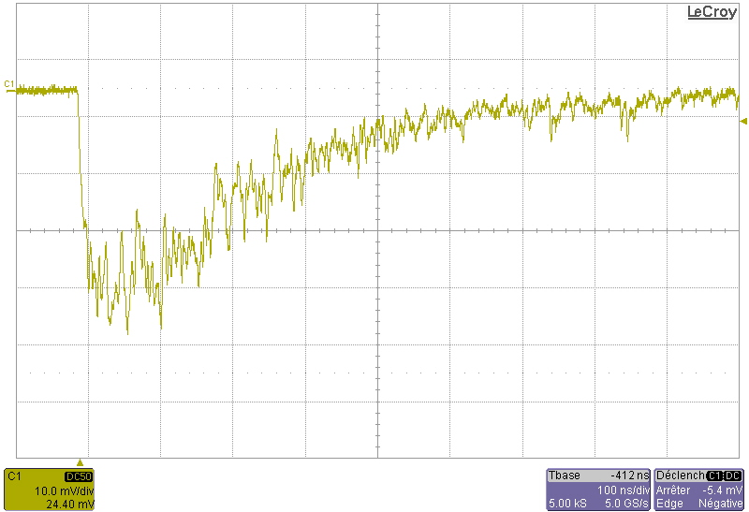
PM signals quantification.
…Toward a good methodology
NaI (Tl)
γ 662keV
This is not (electronics) noise
Just the aleatory time emission of
photons by the scintillator
450ns
500ns
10mV
40mV
Surf = 40 x 450/2 + 10 x 500/2 = 11500 mV.ns
→ 2300 P.E.

Slide 6
PM signals quantification.
…Toward a good methodology
PM Quantum efficiency :
P.E. = Qeff x photons
Qeff
#30%
bialkali
CsI (Tl)
BGO
NaI (Tl) & most organic scintillators
LaBr

Slide 7
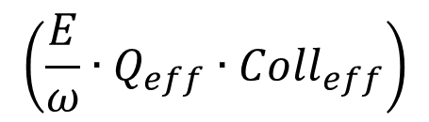
PM signals quantification.
…Toward a good methodology
So, I measured 2300 P.E. for 662keV
$$\left(\frac{E}{ω}∙Q_{eff}∙{Coll}_{eff}\right)$$
I should have
Collection efficiency # 46%
ω is about 40eV for NaI(Tl)
Qeff # 0.3 for my XP2020
+

Slide 8
PM signals quantification.
…Toward a good methodology
photocathode
Stupid, I am!!!
2R_{pk} # 4,2cm
NaI(Tl)
2R_{pm} # 5,25cm
XP2020
Useful Area / PM Area = 0,64 !!!

Slide 9
PM signals quantification.
…Toward a good methodology
Compton Plateau
Tot. Abs. Peak
NaI (Tl)
# 46keV_{rms}
BC400
aucun
LaBr
# 9keV_{rms}
Note: spectra have
been shifted of a decade
for clarity
#470keV
662keV

Slide 10
PM signals quantification.
…Toward a good methodology
It is easy, and often useful, to check detectors basic properties
In an instrumentation chain, some things are not calculable
(for instance, here, the collection efficiency)
But, with the help of simple measurements, it’s always
possible and instructive to infer these (human) parameters.
It explains how our understanding of the chain is far (or not)
from it’s real performances
LaBr is cool, what a pity it’s so expensive…
Btw, somebody broke mine, does someone have 5000€ to give me? Nop?
That’s all folks!

