Slide 1
Neutron energy measurement
by Time Of Flight (TOF)
In order to illustrate uncertainties measurement,
let’s have a look at neutrons energy measurement by TOF…
The problem :
Liquid scintillator
PM tube
stop
Active taget
neutron
Particles beam
velocity
TOF
L
energy
start

Slide 2
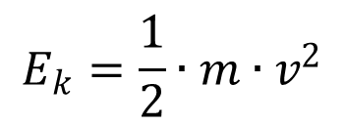
Neutron energy measurement
by Time Of Flight (TOF)
We suppose (for convenience) our neutron is not relativistic
$$v=\frac{1}{c}∙\frac{L}{stop−start}$$
cm
L = 100cm
stop-start = 22.8 ns
→ v = 0.146 c
→ Ek = 10MeV
It’s velocity is
ns
30cm/ns
$$E_{k}=\frac{1}{2}∙m∙v^{2}$$
And its energy
m=940MeV/c²
What is the uncertainty on Ek ?

Slide 3
Neutron energy measurement
by Time Of Flight (TOF)
We know the liquid scintillator + PM + data acquisition system
$$σ_{stop}=200{ps}_{RMS}$$
We asked the colleagues that built the active target. They told us:
$$σ_{start}=400{ps}_{FWHM}$$
We assume the
distribution Gaussian
$$σ_{start}=170{ps}_{RMS}$$
Anything else?

Slide 4
Neutron energy measurement
by Time Of Flight (TOF)
What about the incident neutron interaction point ?
Reads “z follows an
Exponential pdf of
given rate”
Th = 10cm
Interaction probability # 20% (we know it)
Interaction
Prob. Dens. Funct.
$$z\sim expo\left(\frac{−ln\left(0.8\right)}{Th}\right)$$

Slide 5
Neutron energy measurement
by Time Of Flight (TOF)
The interaction point follows about a uniform law
$$σ_{L}≈\frac{Th}{\sqrt{12}}=2.9cm$$
Th = 10cm

Slide 6
Neutron energy measurement
by Time Of Flight (TOF)
The interaction point follows about a uniform law
$${σ_{Y}}^{2}=\sum_{i=1..N}{{\left(\frac{∂f}{∂X_{i}}\right)}^{2}∙{σ_{X_{i}}}^{2}}$$
$$E_{k}=\frac{1}{2}∙m∙{\left(\frac{1}{c}∙\frac{L}{stop−start}\right)}^{2}$$
$$σ_{E}=m_{n}∙\frac{L}{c^{2}∙T^{2}}∙σ_{L}⊕$$
$$m_{n}∙\frac{L^{2}}{c^{2}∙T^{3}}∙σ_{t_{start}}⊕m_{n}∙\frac{L^{2}}{c^{2}∙T^{3}}∙σ_{t_{stop}}$$

Slide 7
Neutron energy measurement
by Time Of Flight (TOF)
Uncertainty budget :
parameter
contribution
type
Interaction point uncertainty
$$σ_{L}≈\frac{Th}{\sqrt{12}}=2.9cm$$
0.58 MeV
A
Uniform pdf
start
0.18 MeV
A
Normal pdf
$$σ_{start}=170{ps}_{RMS}$$
stop
Normal pdf
assumed
0.15 MeV
B
$$σ_{stop}=200{ps}_{RMS}$$
Combined uncertainty →
0.63 MeV

Slide 8
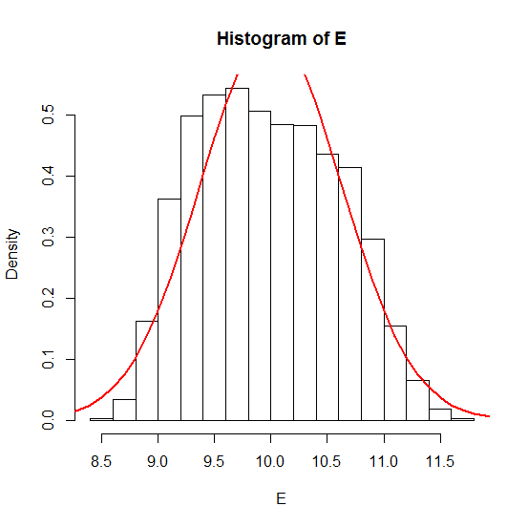
Neutron energy measurement
by Time Of Flight (TOF)
Let’s compare what we did with
a full MC simulation :
Uncertainties
Budget result
Not so bad, in fact!
Moreover, now, we have the
equations of our problem at any energy and we
can play with them in order to OPTIMIZE our experiment!
MC results

Slide 9
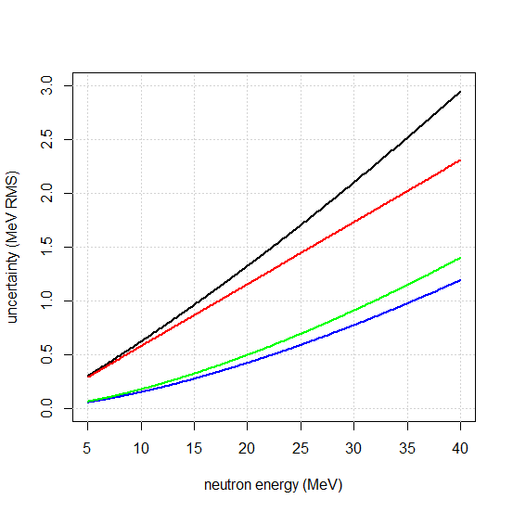
Neutron energy measurement
by Time Of Flight (TOF)
For instance: what are the result for a complete neutron spectrum
ranging from 5MeV to 40MeV ?
Total
Interation point
Stop
start
Beware :
Maybe we should
express energy with
relativistic corrections…
Beware :
Maybe we should
have included variable
detection efficiencies
But it’s not far from truth

Slide 10
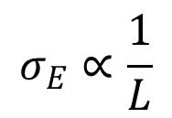
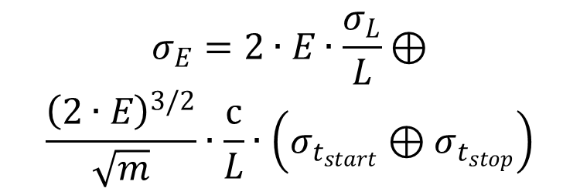
Neutron energy measurement
by Time Of Flight (TOF)
For instance: at what distance should we put the stop detector
in order to have it’s contribution to uncertainty lower than
other uncertainties (start & stop)?
We just have to express the uncertainty, making E apparent:
$$σ_{E}=2∙E∙\frac{σ_{L}}{L}⊕$$
$$\frac{{\left(2∙E\right)}^{3/2}}{\sqrt{m}}∙\frac{c}{L}∙\left(σ_{t_{start}}⊕σ_{t_{stop}}\right)$$
$$σ_{E}∝\frac{1}{L}$$
To see it’s not possible…
But we learn that

Slide 11
Neutron energy measurement
by Time Of Flight (TOF)
Calculating uncertainties by the mean of metrology techniques
is not a mean to avoid MC approach's.
It is often harder (at the beginning) and it obliges you to focus
on important points
Thus, it gives you a deeper sight into your process
→ It is a good way to OPTIMIZE your designs
MC techniques are generally the only way to get the pdf.
That’s all folks!

