Slide 1
n/γ discrimination
How to be sure an event we recorded is a n, not a γ ?
The problem…
Scintillator
Prompt γ
Active taget
neutron
Particles beam
neutrons
γ
activation
TOF
neutron
Concrete wall
decay
activation
time

Slide 2
n/γ discrimination
The problem…
Some scintillators exhibit a pulse shape dependence on
incident particle nature (anthracene, liquid scintillators, …)
The solution:
Pulse shape discrimination, using various integration gates
or optimal filtering…

Slide 3
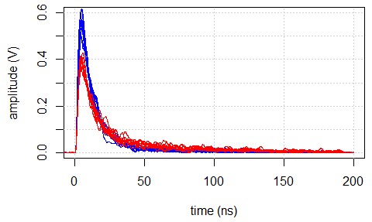
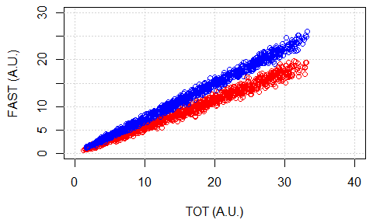
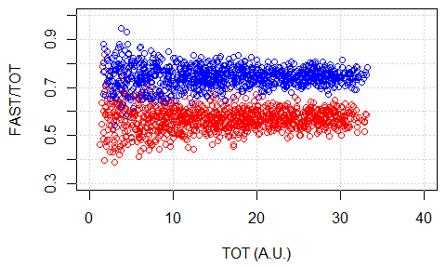
n/γ discrimination
Pulse shape discrimination using various gates :
γ
n
energy
TOT
Integration
gates
analysis
FAST
DELAYED
Gate tuning

Slide 4
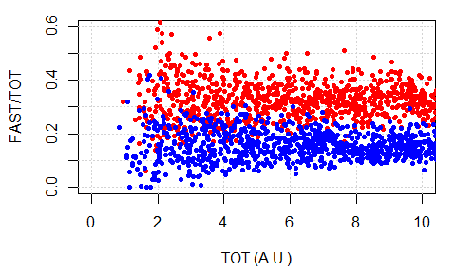
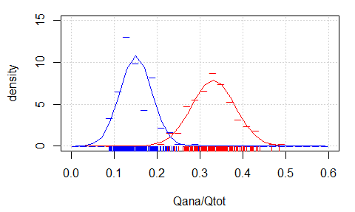
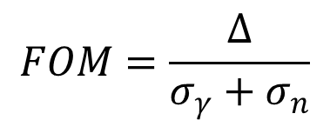
n/γ discrimination
One step toward optimization:
1) define the factor of merit (FOM) of your technics
Δ
FOM=1.78
γ
n
σ_{γ}
σ_{n}
ANA = [30ns, 190ns]
About 100 PE.
$$FOM=\frac{∆}{σ_{γ}+σ_{n}}$$
It depends on your intends

Slide 5
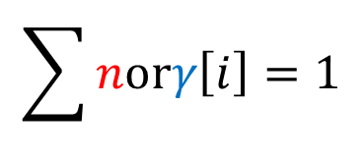
n/γ discrimination
One step toward optimization:
This is what interests us
2) define signal
$$v\left[i\right]=N∙V_{1}∙norγ\left[i\right]+n_{i}+BL$$
With :
$$N$$
The total number of PEs in the full pulse
$$V_{1}$$
The voltage drop for 1PE (2mV for instance)
$$\sum{norγ\left[i\right]}=1$$
$$norγ\left[i\right]$$
The pdf of n or γ pulses
$$n_{i}$$
Noise at sample I (mean ni=0)
$$BL$$
Baseline for the pulse (=constant for one pulse
, mean over pulses = 0)

Slide 6
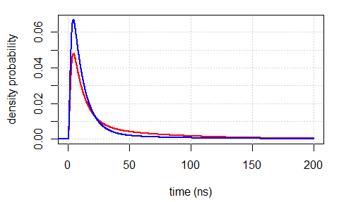
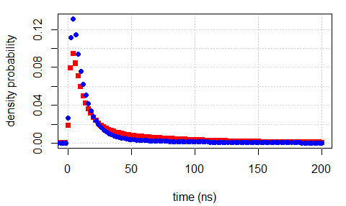
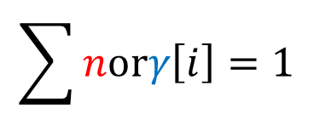
n/γ discrimination
One step toward optimization:
2) define signal
$$norγ\left[i\right]$$
The pdf of n or γ pulses
$$\sum{norγ\left[i\right]}=1$$

Slide 7
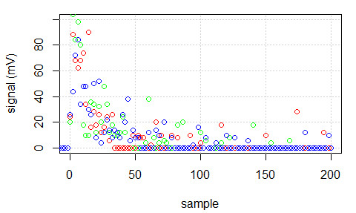
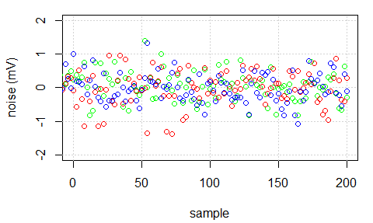
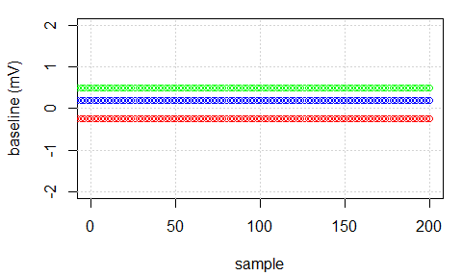
n/γ discrimination
One step toward optimization:
PE signal
N=100
V1=8mV.ns
2) define signal
noise
baseline
Vrms=0.45
BL=0.5

Slide 8
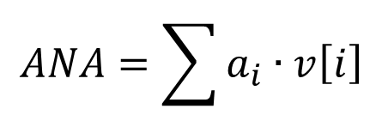
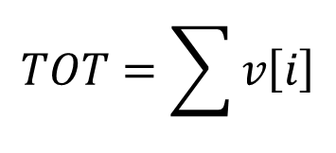
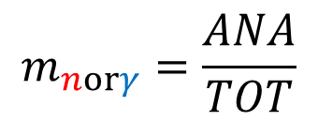
n/γ discrimination
One step toward optimization:
3) Define the measurement, for instance:
$$TOT=\sum{v\left[i\right]}$$
$$ANA=\sum{a_{i}∙v\left[i\right]}$$
Here, we made a dot product of the analysis vector and signal
This is like filtering…
For the moment, we don’t know the Analysis vector.
$$m_{norγ}=\frac{ANA}{TOT}$$
Leading to :

Slide 9
n/γ discrimination
Pulse shape discrimination using various gates :
3) define the measurement uncertainty
$$m=\frac{\sum{a_{i}∙N∙V1∙norγ\left[i\right]}+\sum{a_{i}∙n_{i}}+BL∙\sum{a_{i}}}{\sum{t_{i}∙N∙V1∙norγ\left[i\right]}+\sum{t_{i}∙n_{i}}+BL∙\sum{t_{i}}}$$
$${σ_{m}}^{2}={σ_{pulse}}^{2}+{σ_{noise}}^{2}+{σ_{baseline}}^{2}$$
Remember ni & BL are null on average

Slide 10
n/γ discrimination
Pulse shape discrimination using various gates :
3) define the measurement uncertainty
$${σ_{pulse}}^{2}$$
$$m=\frac{\sum{a_{i}∙N∙V1∙norγ\left[i\right]}+\sum{a_{i}∙n_{i}}+BL∙\sum{a_{i}}}{\sum{t_{i}∙N∙V1∙norγ\left[i\right]}+\sum{t_{i}∙n_{i}}+BL∙\sum{t_{i}}}$$
Remember ni & BL are null on average
Excess noise factor
PE count at index i
$${σ_{pulse}}^{2}=\sum{{\left(\frac{a_{i}∙\sum{t_{i}∙N∙V1∙norγ\left[i\right]}−t_{i}∙\sum{a_{i}∙N∙V1∙norγ\left[i\right]}}{{\left(\sum{t_{i}∙N∙V1∙norγ\left[i\right]}\right)}^{2}}\right)}^{2}∙{V1}^{2}∙N∙norγ\left[i\right]∙F}$$
Average charge for 1PE

Slide 11
n/γ discrimination
Pulse shape discrimination using various gates :
3) define the measurement uncertainty
$${σ_{noise}}^{2}$$
$$m=\frac{\sum{a_{i}∙N∙V1∙norγ\left[i\right]}+\sum{a_{i}∙n_{i}}+BL∙\sum{a_{i}}}{\sum{t_{i}∙N∙V1∙norγ\left[i\right]}+\sum{t_{i}∙n_{i}}+BL∙\sum{t_{i}}}$$
Electronics noise
Remember ni & BL are null on average
$${σ_{noise}}^{2}=\sum{{\left(\frac{a_{i}∙\sum{t_{i}∙N∙V1∙norγ\left[i\right]}−t_{i}∙\sum{a_{i}∙N∙V1∙norγ\left[i\right]}}{{\left(\sum{t_{i}∙N∙V1∙norγ\left[i\right]}\right)}^{2}}\right)}^{2}∙{v_{RMS}}^{2}}$$

Slide 12
n/γ discrimination
Pulse shape discrimination using various gates :
3) define the measurement uncertainty
$${σ_{baseline}}^{2}$$
$$m=\frac{\sum{a_{i}∙N∙V1∙norγ\left[i\right]}+\sum{a_{i}∙n_{i}}+BL∙\sum{a_{i}}}{\sum{t_{i}∙N∙V1∙norγ\left[i\right]}+\sum{t_{i}∙n_{i}}+BL∙\sum{t_{i}}}$$
Remember ni & BL are null on average
$${σ_{baseline}}^{2}={\left(\frac{\sum{a_{i}}∙\sum{t_{i}∙N∙V1∙norγ\left[i\right]}−\sum{t_{i}}∙\sum{a_{i}∙N∙V1∙norγ\left[i\right]}}{{\left(\sum{t_{i}∙N∙V1∙norγ\left[i\right]}\right)}^{2}}\right)}^{2}∙\frac{1}{2}∙{BL}^{2}$$
Baseline variance :we assume constant baseline related to slow varying
Sinus baseline of BL amplitude (2 x BL pk to pk)

Slide 13
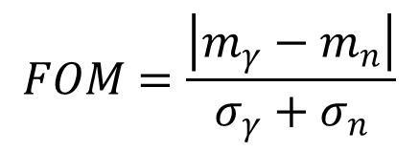
n/γ discrimination
Pulse shape discrimination using various gates :
3) Complete the FOM
$$FOM=\frac{\left|m_{γ}−m_{n}\right|}{σ_{γ}+σ_{n}}$$
For N=100, V1=8mV.ns, F=1.25, Vrms=0.5, ANA=[30ns, 190ns]
→ We find FOM=1.8 (and with the MC, FOM=1.78)… not stupid!
Remember, we are seeking ai’s giving the best possible FOM…

Slide 14
n/γ discrimination
Pulse shape discrimination using various gates :
3) Optimize your FOM, in fact, we will let R do it for you…
signal <- function (A, T, S, N) {
sum(A * S) / sum(T * S)
}
noise <- function (A, T, S, N) {
num <- sum(A * S) * V1 * N
den <- sum(T * S) * V1 * N
v.quanta <- sum (((A*den-T*num)/den^2)^2 * V1^2 * S * 1.25 * N)
v.noise <- sum (((A*den-T*num)/den^2)^2 * Vrms^2)
v.baseline <- ((sum(A)*den-sum(T)*num)/den^2)^2 * 0.5 * BL^2
sqrt(v.quanta+v.noise+v.baseline)
}
A = Analysis gate
T = Total energy gate
S = signal (neutron or gamma)
N = PE count

Slide 15
n/γ discrimination
Pulse shape discrimination using various gates :
3) Optimize your FOM, in fact, we will let R do it for you…
FOM <- function (A, T, N) {
delta <- abs (signal(A, T, s.neut, N)-signal(A, T, s.gamm, N))
delta / (noise (A, T, s.neut, N) + noise (A, T, s.gamm, N))
}
cost <- function (params, ...) {
-FOM(params, ...)
}
A <- c(rep(0,20), rep(1, 106-20))
T <- rep(1, length(A))
A_ <- nlm (cost, A, T, 50)
nlm performs a minimization

Slide 16
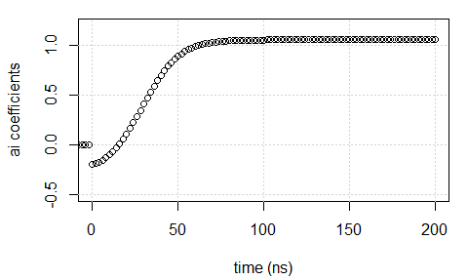
n/γ discrimination
Pulse shape discrimination using various gates :
3) Optimize your FOM, in fact, we will let R do it for you…
No baseline variation
FOM=1.95

Slide 17
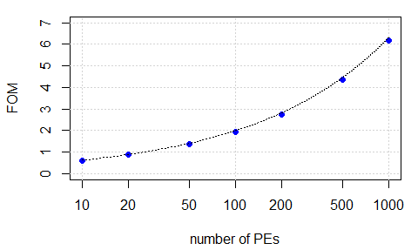
n/γ discrimination
Time for playing: how FOM varies with PEs number ?
Noise = 0mV
BL = 0mV
N=100
FOM = 1.95
$$FOM∝\sqrt{N}$$

Slide 18
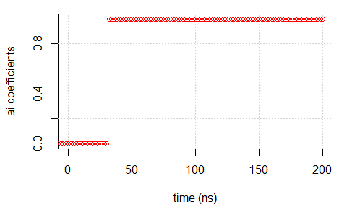
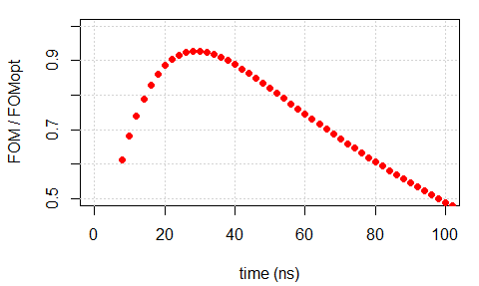
n/γ discrimination
Time for playing: let’s fight !
Noise = 0mV
BL = 0mV
FOM = 1.95
Vs.
FOM = 1.81
Not so bad for
a simple gate…
Gate tuning is
relatively
permissive!

Slide 19
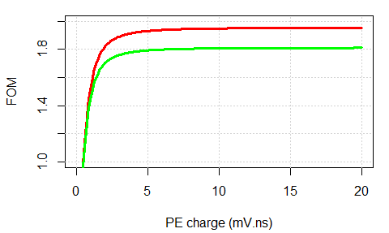
n/γ discrimination
Time for playing: how does FOM vary with PM gain ?
Red : optimal filter
Green : best integration gate
Gain # 10⁶
Vrms = 0.5mV
BL = 0mV
N = 100PE
Once noise floor reached, FOM does not change anymore.
We are counting Pes → Poisson law IS the quantum limit

Slide 20
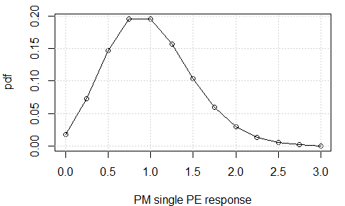
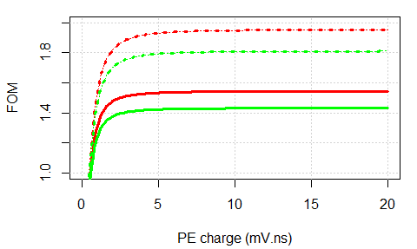
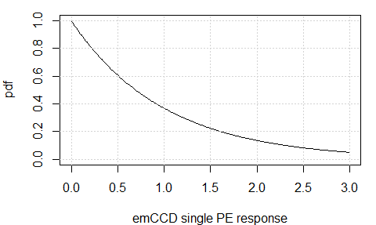
n/γ discrimination
Time for playing: how does FOM vary with PM PE spectrum ?
Good PM
Good PM
Single PE spectra
Bad PM
Bad PM
The single PE spectrum of your favorite PM tube
Is one of the major influence parameter of the FOM

Slide 21
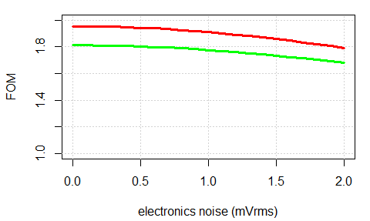
n/γ discrimination
Time for playing: how does FOM vary with electronics noise ?
Red : optimal filter
Green : best integration gate
BL = 0mV
N = 100PE
Not so much in fact…

Slide 22
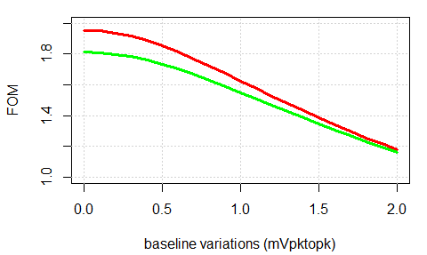
n/γ discrimination
Time for playing: how does FOM vary with baseline ?
Red : optimal filter
Green : best integration gate
Vrms = 0mV
N = 100PE
Ouch catastrophe!!!
Slight variations of baseline can be disastrous in n/γ discrimination
You should carefully review yours EMC…

Slide 23
n γ discrimination
REMEMBER : All that was said is perfectly TRUE
for digital acquisition systems only
where electronics noise is perfectly correlated (once acquired)
Details (gate start, duration, …) depends on your scintillator
REMEMBER, we are counting photons:
1PE = 8mVns (for instance)
1mVbaseline fluctuation x 200ns = 40PE!!!
For best performances, use PM tube
with good single PE spectrum
high quantum efficiency (obvious)
That’s all folks!

